Slide 1
2022/2023 美国玉米出口品质报告2022/2023 U.S. Corn Export Cargo Quality Report
桑切斯 Manuel Sanchez
美国谷物协会北京办事处主任
Director, U.S. Grains Council – PRC Office
Notes:
The U.S. Grains Council is pleased to present our twelfth annual U.S. Corn Export Cargo Quality Report, which provides the results from early 2022/2023 corn exports.

Slide 2
优质、可靠、透明 Quality, Reliability, Transparency
2022/2023玉米品质报告 Corn Quality Report
对收获和早期出口玉米品质进行的系统调查Systematic survey of corn quality at harvest and of early exports
在信任的基础上建立伙伴关系
Building partnerships based on trust
建立世界上最大、最可靠的谷物供应的桥梁
Bridge to world’s largest, most reliable grain supply
透明和一致的方法 Transparent and Consistent Methodology
可靠和可对比的数据 Reliable and Comparable Data
Notes:
The success of the U.S. corn export system over the past 50 years has been built on a tradition of quality, reliability and transparency in our marketing system.
The U.S. Grains Council has worked for more than 50 years to build partnerships based on trust with importers of U.S. corn, as your bridge to the most reliable supplier of corn to the world.
To enhance the quality of information we provide to export customers about the quality of the U.S. corn supply, the U.S. Grains Council in 2011 initiated a series of annual Corn Quality Reports that we develop in two parts: First, a Harvest Quality Report surveys U.S. corn quality at harvest as it enters the marketing system and is published in November. Then a follow-up report, the Export Cargo Quality Report, looks at the quality of the corn crop as it is assembled for export early in the marketing year.
These two reports provide a systematic annual look at the quality of the U.S. corn crop, using reliable data and a transparent, consistent methodology each year. We have established processes for sample collection and testing, and in following those processes year after year, we are assembling a valuable database of information about U.S. corn quality.
It is important to study BOTH the Harvest Quality Report and the Export Cargo Quality Report. As we accumulate additional years of these reports, they are becoming more valuable in giving export customers an understanding of the relationship between growing conditions, harvest quality and early export quality of U.S. corn.

Slide 3
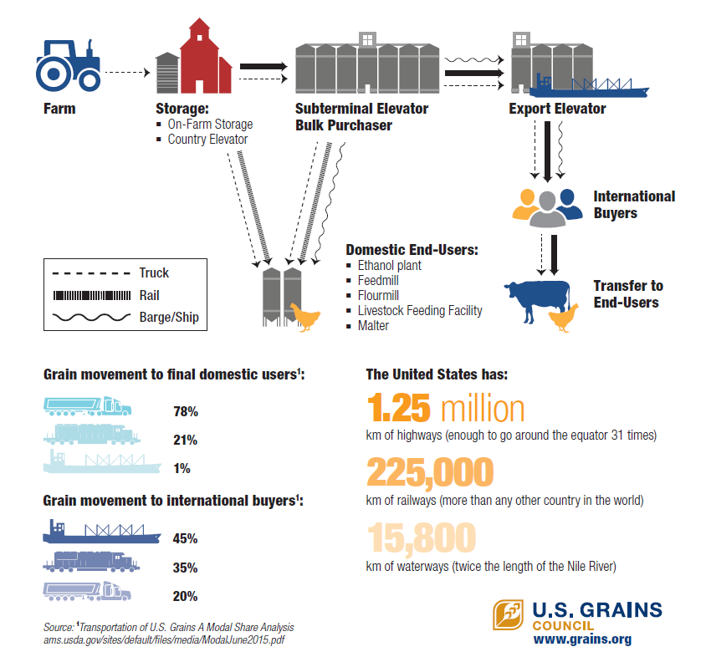
美国谷物运输旅程 How Does U.S. Grain Move?
粮食中转收购站
大宗采购商
出口粮食收购站
农场
储存：
农场
国家粮食收购站
国内终端用户：
乙醇厂
饲料厂
畜禽养殖场
麦芽厂
国际买家
转运到终端用户
卡车
铁路
驳船/轮船
到达国内终端用户的运输方式占比
美国有：
125万公里的公路（足以绕赤道31圈）
22万5千公里的铁路（全世界最长）
1万5800公里的水路（尼罗河的两倍）
到达国家买家的运输方式占比

Slide 4
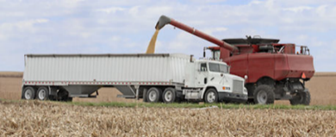
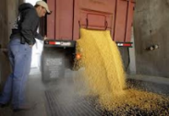
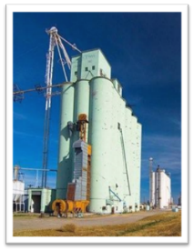
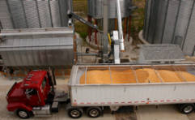
收获品质报告 Harvest Quality Report
收获品质报告HARVEST QUALITY REPORT
Notes:
The Harvest Quality Report and the Export Cargo Report complement each other because of the information they provide about U.S. corn quality at harvest, and then at export after the corn has passed through the U.S. corn marketing system.
The Harvest Quality Report provides quality parameters for samples of corn taken at harvest from local grain elevators.
At harvest, the corn has generally been handled only once or twice: from the field to a truck and directly to the local grain elevator, or from the field to a truck to on-farm storage, and again onto a truck for transport to the local grain elevator.

Slide 5
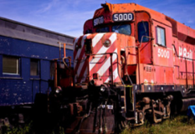
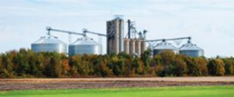
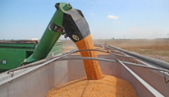
出口货物品质报告 Export Cargo Quality Report
出口货物报告EXPORT CARGO REPORT
Notes:
The Export Cargo Report assesses corn as it is prepared for loading into ships or railcars for final export. The corn loaded for export has been handled several times since harvest as it was loaded into trucks, railcars, and barges and transported in one, two or three steps to the export elevators. In the process, the corn has been conditioned to reduce moisture levels, and has been mixed with corn from other farms and elevators. In many cases, corn is blended to not exceed the limits of U.S. grading standards, and each stage of handling can affect some of the quality parameters of the corn.

Slide 6
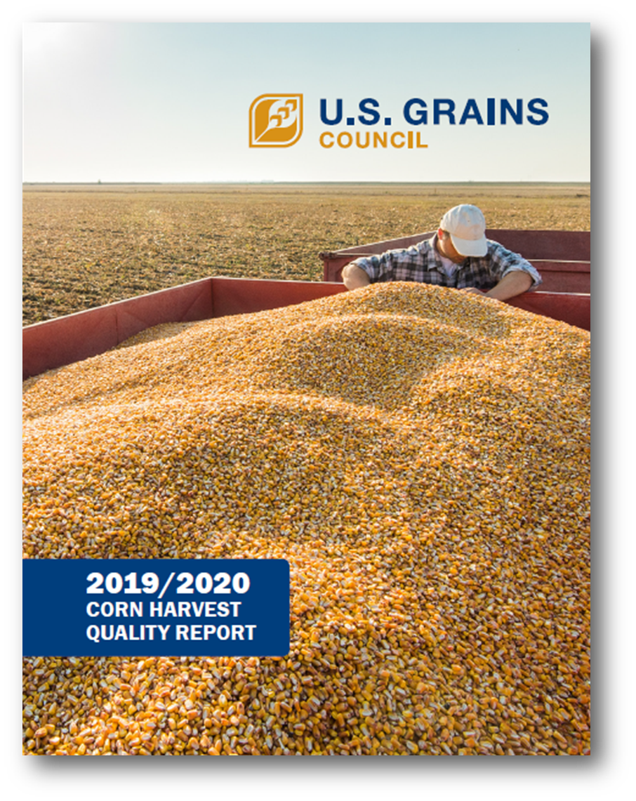
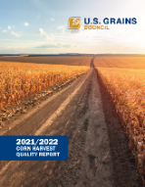
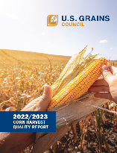
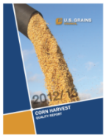
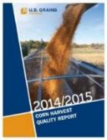
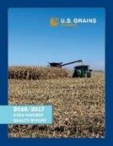
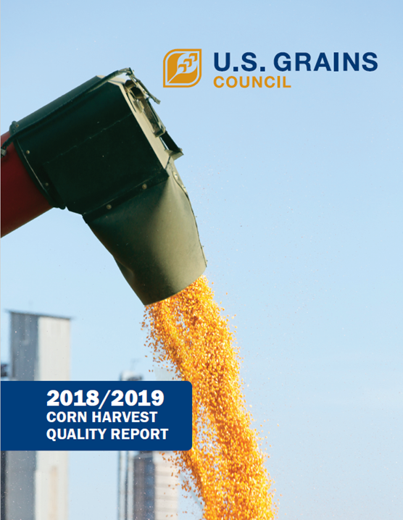
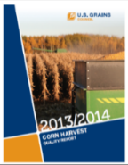
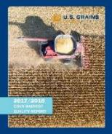
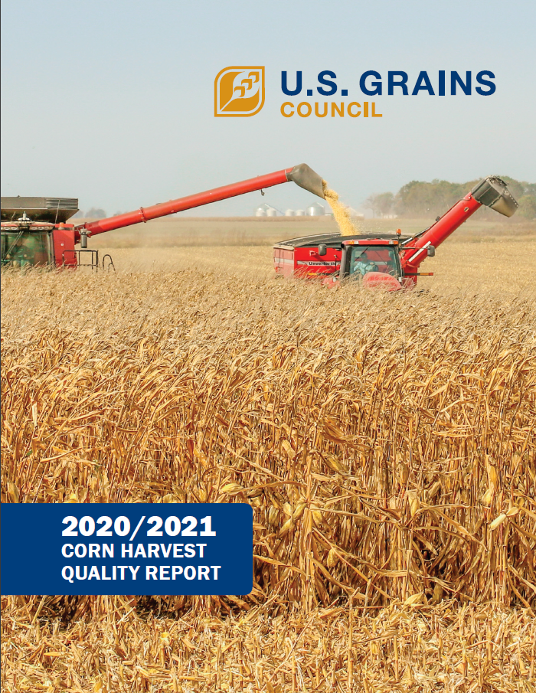
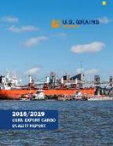
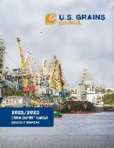
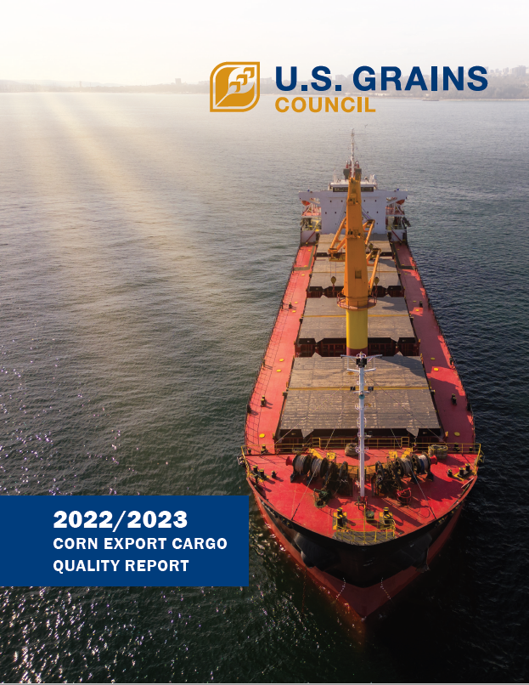
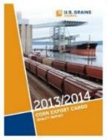
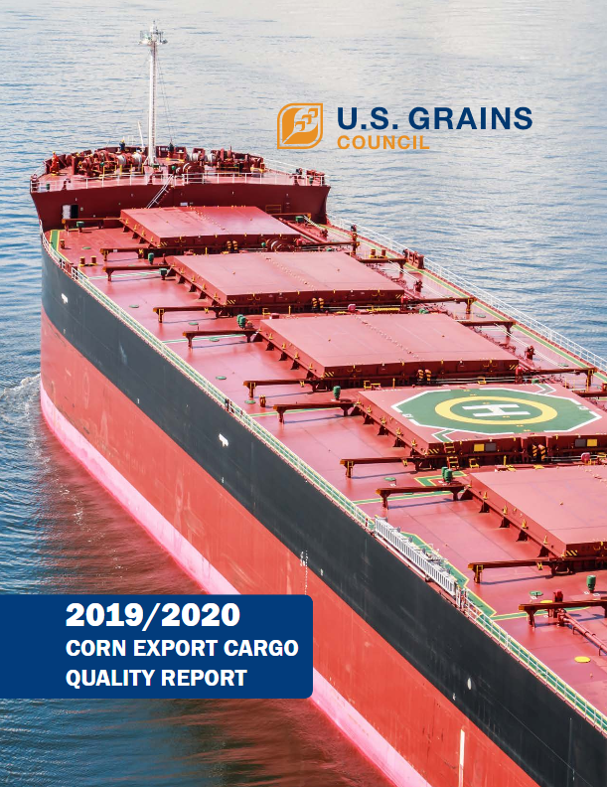
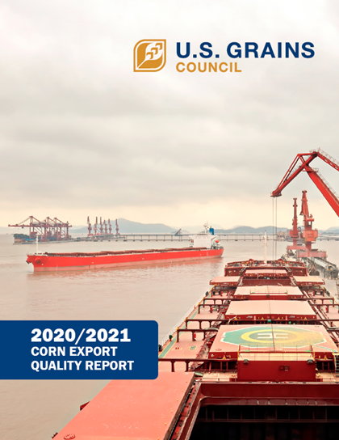
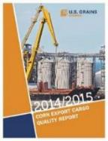
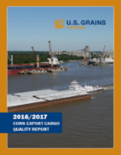
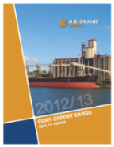
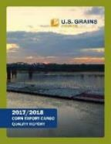
美国谷物协会玉米品质报告 USGC Corn Quality Reports
2011/2012年至2022/2023年
2011/2012 through 2022/2023
2022/2023年
收获
Harvest
12th
出口货物
Export Cargo
Notes:
This is the twelfth year in which these corn quality surveys have been conducted. When studied along with the Harvest Quality Report, these annual reports enable readers to compare the following:
1- Quality factors at export with those same factors at harvest.
2- The corn quality produced and exported across different crop years.
As these reports are accumulating, they are helping export customers build an understanding of what they can expect in the quality of U.S. corn exports.

Slide 7
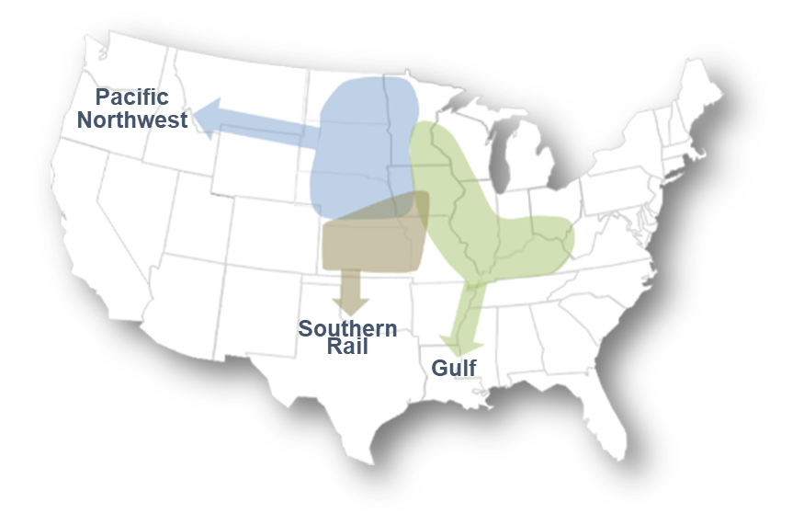
出口集中区 “Export Catchment Areas” (ECA)
430份出口样本，
来自代表大约90%的
美国出口玉米的出口集中区
430 export samples targeted from ECAs representing approximately 90% of U.S. Corn Exports
西北太平洋26.2%
南部铁路 17.9%
墨西哥湾55.9%
Notes:
A total of 430 samples were targeted for this year’s Export Cargo Report.
A total of 474 samples were collected from U.S. corn lots being assembled for export.
For the 2022/2023 Export Cargo Report, corn samples were drawn by FGIS officials from three major export regions:
Gulf - Ports in Louisiana; sampling proportion – 55.9%; 240 samples targeted, 249 tested
Pacific Northwest - Ports in Washington state; sampling proportion – 26.2%; 113 samples targeted, 138 collected
Southern Rail - Interior FGIS-designated domestic official service providers; sampling proportion – 17.9%; 77 samples targeted, 87 tested.
The sampling period for this survey was from November 2022 through March 2023. The test results for the samples are reported for the U.S. Aggregate, in addition to the three ECAs.

Slide 8
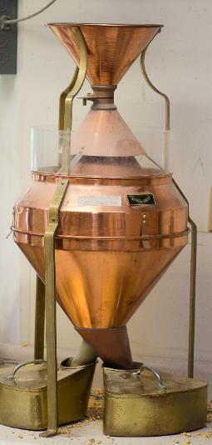
品质指标检测Quality Factors Tested
定等指标 Grading Factors
容重Test weight
破碎玉米 Broken corn
杂质 Foreign material
总损 Total damage
热损 Heat damage
物理指标 Physical Factors
应力裂纹 Stress cracks
百粒重 100-kernel weight
颗粒体积 Kernel volume
颗粒真实密度 True density
完整颗粒比例 Whole kernels
角质（硬）胚乳 Horneous (hard) endosperm
化学成分 Chemical Composition
蛋白 Protein
淀粉 Starch
油 Oil
霉菌毒素 Mycotoxins
黄曲霉毒素 Aflatoxin
呕吐毒素 DON (Vomitoxin)
伏马菌素 Fumonisin
赭曲霉毒素 Ochratoxin A
T-2
玉米赤霉烯酮 Zearalenone
Notes:
The Export Cargo Quality Report includes quality tests for the following factors:
U.S. Grade factors – this includes test weight, “broken corn and foreign material” commonly referred to as BCFM, total damage and heat damage, a subset of total damage.
Chemical composition consisting of protein, starch and oil,
Physical factors measuring stress cracks, true density, whole kernels and horneous or hard endosperm; and
Mycotoxins. This report tests for the following mycotoxins of interest – aflatoxin, deoxynivalenol (DON) or vomitoxin, fumonisin, ochratoxin A, T-2 and zearalenone.

Slide 9
2022/2023玉米出口品质报告亮点 2022/2023 Corn Export Cargo Quality Report Highlights
总体情况
Overall Crop
定等指标/水分对应五年平均Grade Factors/ Moisture vs. 5YA
化学成分对应五年平均Chemical Composition vs. 5YA
物理指标对应五年平均Physical Factors vs. 5YA
100%样本的呕吐毒素低于FDA 5ppm的建议水平 100.0% of samples below FDA advisory level for DON of 5.0 ppm ‡
霉菌毒素 Mycotoxins
破碎粒和杂质总体平均低于美国二级玉米最高限值 Aggregate average BCFM lower than maximum limit for U.S. No. 2
容重、总损和热损总体平均为一级或更好Aggregate average Test Weight, Total Damage and Heat Damage rated U.S. No. 1 or better
容重 Test Weight 更高 Higher
破碎粒和杂质BCFM 更低Lower
总损 Total Damage 相同Same
蛋白Protein 更高Higher
淀粉Starch 更低Lower
油含量Oil 更低 Lower
应力裂纹 Stress Cracks
更低Lower
百粒重100-Kernel Weight
更低Lower
真密度True Density
更低Lower
完整颗粒Whole Kernels
更高Higher
100.0% 样本的黄曲霉毒素低于FDA的限制水平 100.0% of samples ≤ FDA action level for Aflatoxin‡
94.3 %样本的伏马菌素低于FDA5ppm的建议水平 94.3% of samples ≤ the lowest FDA Fumonisin advisory level of 5 ppm‡
† 5年平均=市场年2017/2018至2021/2022 5YA= Marketing years 2017/2018 through 2021/2022
‡针对饲料用途的限制、建议和指导水平Action, advisory and guidance levels for corn intended for feed use
Notes:
The quality factor’s 2022/2023 average must be statistically different than the 5YA at the 95% confidence level to be described as Higher, Lower, Slightly Higher, or Slightly Lower.

Slide 10
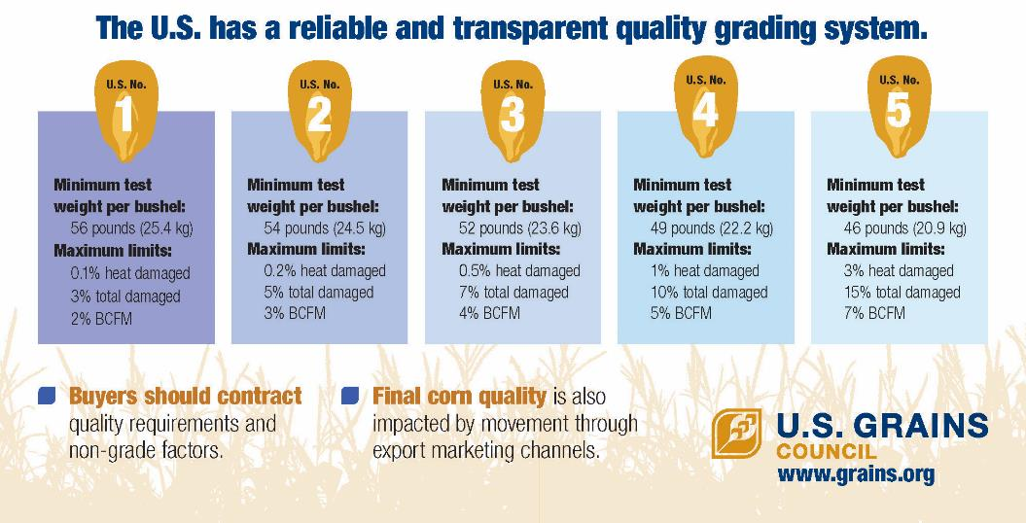
美国农业部玉米品质等级 USDA Corn Quality Grades
美国拥有可靠、透明的玉米品质定等体系
每蒲式耳最低容重
最大值：
热损
总损
BCFM
买家应把玉米等级要求和非等级指标写入合同中
玉米的最终品质也受出口销售渠道运输的影响

Slide 11
等级和等级要求 Grades and Grade Requirements
 | 最低 Minimum |  | 受损颗粒最高限值 Maximum Limits of
 | 容重 Test Weight |  | Damaged Kernels
等级Grade | 磅/蒲式耳 Pounds per Bushel | 千克/百公升 Kilogram per Hectoliter | 热损Heat Damage (%) | 总损Total (%) | 破碎粒和杂质BCFM (%)
一级 U.S. No. 1 | 56.0 | 72.1 | 0.1 | 3.0 | 2.0
二级 U.S. No. 2 | 54.0 | 69.5 | 0.2 | 5.0 | 3.0
三级 U.S. No. 3 | 52.0 | 66.9 | 0.5 | 7.0 | 4.0
四级 U.S. No. 4 | 49.0 | 63.1 | 1.0 | 10.0 | 5.0
五级 U.S. No. 5 | 46.0 | 59.2 | 3.0 | 15.0 | 7.0
Notes:
U.S. corn is traded based on grades established by the U.S. government. In order to meet the requirements for a given grade of corn, a load of corn must achieve the minimum standards for test weight and not exceed maximum standards for heat damage, total damaged kernels and BCFM of that grade.
The key grading factors as shown here are:
Test weight – the chart reports the minimum test weight for each grade; for example, the corn must have a minimum test weight of 54.0 lb/bu to be U.S. Grade No. 2
The chart reports the maximum level for each of the following three factors:
Heat damage, which is a sub-set of total damage
Total damage, and
BCFM, which stands for “Broken Corn and Foreign Material”

Slide 12
等级指标 Grade Factors
 | 样本数Number of Samples | 平均值Average | 标准差Standard Deviation | 最小值Minimum | 最大值Maximum
容重(磅/蒲式耳) Test Weight (lb/bu) | 297 | 58.0 | 0.63 | 55.6 | 61.3
容重（千克/百公升） Test Weight ( kg/hl) | 297 | 74.6 | 0.81 | 71.6 | 78.9
破碎粒和杂质BCFM (%) | 300 | 2.7 | 0.41 | 0.8 | 3.9
总损 Total Damage (%) | 300 | 2.3 | 1.53 | 0.2 | 31.1
热损 Heat Damage (%) | 300 | 0.0 | 0.00 | 0.0 | 0.1
Notes:
This table presents the grade factors and moisture results at the U.S. Aggregate level. The U.S. Aggregate includes the entire number of samples collected and tested for this year’s Corn Export Cargo Quality Report. The average, standard deviation, minimum and maximum values for each of the quality factors are shown here. For example, we can see that the average test weight for the U.S. Aggregate was 58.0 pounds per bushel or 74.6 kilograms per hectoliter. The standard deviation for test weight was 0.63 lb/bu or 0.81 kg/hl. The lowest and highest test weights seen in the 297 observations were 55.6 and 61.3 lb/bu, respectively (or 71.6 and 78.9 kg/hl).
​
We will review the results for each of the quality factors on the following slides.

Slide 13
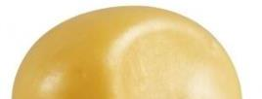
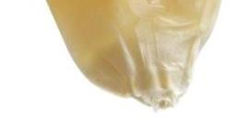
化学成分 Chemical Composition
对家禽和家畜饲养很重要
供应必需氨基酸 Important for poultry and livestock feeding
Supplies essential amino acids
影响因素nfluenced by
遗传、天气、单产、生长季节的可用氮 Genetics, weather, crop yields and available nitrogen during the growing season
蛋白Protein
影响因素 Influenced by
遗传、天气和单产
Genetics, weather and crop yields
对湿磨和干磨乙醇制造商很重要 Important for wet millers and dry-grind ethanol manufacturers
淀粉Starch
湿磨和干磨的重要副产品
必需饲料成分 Important by-product of wet and dry milling
Essential feed component
油含量Oil
Notes:
Protein is important for poultry and livestock feeding and supplies essential amino acids. Protein content is influenced by genetics, weather, crop yields and available nitrogen during the growing season.
Starch is important for wet millers and dry-grind ethanol manufacturers, while oil is an important by-product of wet and dry milling, and an essential feed component. Both starch and oil contents are influenced by genetics, weather and crop yields.
The weather conditions during the grain-filling period in July and August are critical to determining final grain composition. During this time, moderate rainfall and cooler-than-average temperatures, especially overnight temperatures, promote starch and oil accumulation and increased yields. Moderate rainfall and warm temperatures in the second half of grain-fill (August to September) also aid continued nitrogen uptake and photosynthesis. Nitrogen also remobilizes from the leaves to the grain during late grain-filling, leading to increases in grain protein.

Slide 14
化学成分 Chemical Composition
 | 样本数Number of Samples | 平均值Average | 标准差Standard Deviation | 最小值Minimum | 最大值Maximum
蛋白（干基%） Protein (Dry Basis %) | 462 | 8.7 | 0.34 | 7.7 | 9.9
淀粉 （干基%） Starch (Dry Basis %) | 462 | 71.9 | 0.51 | 69.5 | 77.1
油含量 （干基%） Oil (Dry Basis %) | 462 | 3.9 | 0.19 | 3.2 | 4.9
Notes:
This table presents the results for chemical composition for the U.S. Aggregate. The U.S. Aggregate includes the entire 462 samples collected and tested for this year’s Corn Export Cargo Quality Report. The average, standard deviation, minimum, and maximum values for each of the quality factors are shown here. For example, we can see that the average protein for the U.S. Aggregate was 8.7% on a dry basis. The standard deviation for protein was 0.34%. The lowest and highest protein values in the samples were 7.7% and 9.9%, respectively.
We will review the results for each of the quality factors on the following slides.

Slide 15
出口货物霉菌毒素检测 Export Cargo Mycotoxin Testing
评估美国玉米在市场年度早期玉米到达出口终端时黄曲霉毒素、呕吐毒素、伏马菌素、赭曲霉毒素A、T-2和玉米赤霉烯酮的情况 Provides an assessment of the presence of aflatoxin, DON, fumonisin, ochratoxin A, trichothecenes (T-2) and zearalenone in U.S. corn as it reaches export points early in the marketing year
对175份出口玉米样本进行了霉菌毒素的检测 175 export cargo samples tested for mycotoxins
仅报告在出口样本中检测到霉菌毒素水平升高的频率 Reports ONLY the frequency of detected elevated levels of the mycotoxins in export samples
Notes:
No specific levels of the mycotoxins are reported.
A total of 175 samples collected for the report were tested for aflatoxin, DON, fumonisin, ochratoxin A, trichothecenes (T-2) and zearalenone.
The results are reported in frequency distribution charts rather than as aggregate averages.
​
For more information about mycotoxins, mycotoxin testing and U.S. government limitations on mycotoxins in food and feed, see the Export Cargo Report text. ​
​
These results should be used only as one indicator of the potential for mycotoxin infection. Over several years, the Export Cargo Reports will reflect the year-to-year pattern of mycotoxin presence in corn exports early in the marketing year, and the change in mycotoxin presence in corn from harvest to export point.

Slide 16
黄曲霉毒素检测结果 Aflatoxin Testing Results (ppb)
2022/2023年度未检出黄曲霉毒素的出口样本比例低于前两年 2021和2020的样本 A lower proportion of the export samples had no detectable levels of aflatoxin in 2022/2023 compared to the two previous years
所有送检样本都低于FDA 20.0 ppb的限制水平 All samples tested below the FDA action level of 20 ppb
按市场年分列的样本百分比 Percent of Samples by Marketing Year
Notes:
A total of 175 samples collected for the report were tested for aflatoxin.
The EnviroLogix AQ 309 BG test kit was used to conduct the 2022/2023 aflatoxin tests. It has a limit of detection (LOD) for the is 2.7 parts per billion for aflatoxin. This kit’s LOD is more sensitive than the threshold established by the USDA FGIS, known as the “Lower Conformance Level” (LCL), to determine whether a detectable level of aflatoxin appeared in the sample. The LCL for this year’s report was 5 parts per billion (ppb) for aflatoxin. This was used to define the boundary for the first bucket of the frequency distribution displayed in the chart above.
Illinois Crop Improvement Association provided aflatoxin test results for samples in the 2022/2023 Export Cargo Report. This represents a change from the previous reports as nearly all aflatoxin results were provided by FGIS. In previous reports, samples were tested at Illinois Crop Improvement Association only when this information was lacking from the FGIS pan tickets (testing certificates) included with the samples or when one or more of the three composited sub-samples from the Southern Rail ECA has >5ppb. In these cases, the composited sample was tested for aflatoxin. ​
​There are four types of aflatoxin naturally found in foods – aflatoxins B1, B2, G1, and G2. These four aflatoxins are commonly referred to as “aflatoxin”, “aflatoxins”, “total aflatoxin” or “total aflatoxins.”
Aflatoxin production by the Aspergillus family of molds is induced by stress of hot temperatures, low precipitation and drought conditions during flowering followed by periods of high humidity with warmth. While it was hot and mostly dry throughout the corn-growing region before pollination, temperatures moderated and cooled for grain-fill. Therefore, weather conditions in 2021 were not conducive to the development of aflatoxins.
EnviroLogix AQ 309 BG quantitative test kit was used for the aflatoxin analysis. The aflatoxin was extracted with buffered water (3:1). The extracts were tested using the EnviroLogix QuickTox lateral flow strips, and the QuickScan system quantified the mycotoxins. The limit of detection for the EnviroLogix AQ 309 BG is 2.7 parts per billion for aflatoxin.

Slide 17
呕吐毒素检测结果 DON (Vomitoxin) Testing Results (ppm)
98.9% 的送检样本呕吐毒素检测结果低于1.5ppm 98.9% of samples had DON results below 1.5 ppm,
所有样本的呕吐毒素检测结果都低于FDA5.0ppm的建议水平 All samples had DON results below the 5.0 ppm FDA advisory level
按市场年分列的样本百分比 Percent of Samples by Marketing Year
Notes:
A total of 175 samples collected for the report were tested for DON.
The EnviroLogix AQ 304 BG test kit was used to conduct the 2022/2023 DON tests. It has a limit of detection (LOD) for the is 0.1 parts per million for DON.
All samples in the Export Cargo Report were tested by a private lab (Illinois Crop Improvement Association).
​

Slide 18
伏马菌素检测结果 Fumonisin Testing Results (ppm)
94.3% 的送检样本伏马菌素的检测结果都低于FDA5.0ppm的建议水平 94.3% of samples were below the lowest FDA advisory level of 5.0 ppm
按市场年分列的样本百分比 Percent of Samples by Marketing Year
Notes:
A total of 175 samples collected for the report were tested for fumonisin.
This is the fourth year of fumonisin testing in both the Harvest and Export Cargo Reports.
The EnviroLogix AQ 411 BG test kit was used to conduct the 2022/2023 fumonisin tests. It has a limit of detection (LOD) for the is 0.1 parts per million for fumonisin.
All samples in the Export Cargo Report were tested by a private lab (Illinois Crop Improvement Association).

Slide 19
赭曲霉毒素 A 的检测结果 Ochratoxin A Testing Results (ppb)
检测赭曲霉毒素 A 的第二年Second year of ochratoxin A testing
96.6%的送检样本都低于欧洲委员会为赭曲霉毒素A设定的5.0ppb的最高限值 96.6% % of the samples tested below 5.0 ppb, the European Commission’s established maximum level for ochratoxin A.
美国FDA没有发布针对赭曲霉毒素A 的建议水平 The FDA has issued no advisory levels for ochratoxin A.
按作物年分列的样本百分比 Percent of Samples by Crop Year
Notes:
2022/2023 is the second year of ochratoxin A testing in the Export Cargo Report. A total of 175 samples were tested.
96.6% of samples tested in the 2022/2023 report tested below 5 ppb, a higher proportion than in 2021/2022 (80.2%).
The European Commission established a maximum level for ochratoxin A in raw cereals at 5 ug/kg (5 ppb). The FDA has issued no advisory levels for ochratoxin A.
Ochratoxin was tested in the 2022, 2021 and 2020 Harvest Reports. 100.0%, 95.6% and 100.0% of samples tested below 5 ppb in the 2022, 2021 and 2020 reports, respectively.
Aspergillus species and Penicillium verrucosumalso can produce the mycotoxin ochratoxin A. Although ochratoxin A can be produced by Aspergillus pre-harvest, recent studies suggest that conditions during grain storage are more likely to foster production. Development of this mycotoxin is thought to be favored by temperatures fluctuations from warm (28 to 20 ºC), to cool (15 ºC) with high humidity.
The EnviroLogix AQ 113 BG quantitative test kit used for the ochratoxin A tests has a limit of detection of 1.5 parts per billion. The ochratoxin A was extracted with a grain buffer (five milliliters per gram).
Ochratoxin A is often abbreviated as OTA.

Slide 20
T-2 的检测结果 T-2 Testing Results (ppm)
检测T-2的第二年
Second year of T-2 testing
100.0% 的送检样本都低于1.5ppm 100.0% of the samples tested below 1.5 ppm
按作物年分列的样本百分比 Percent of Samples by Crop Year
Notes:
2022/2023 is the second year of T-2 testing in the Export Cargo Report. A total of 175 samples were tested.
All samples in both the 2022/2023 and 2021/2022 Export Cargo Reports tested below 1.5 ppm.
Trichothecenes (T-2), produced by F. langsethiae, F. sporotrichioides, or F. graminearum- may be produced when it’s cool and rainy for about 2 weeks before pollination, then warm (20-30 ºC) for early grain-fill (3 weeks after anthesis), with high humidity.
T-2 was tested in the 2022, 2021 and 2020 Harvest Reports. 100.0% of samples tested below 1.5 ppm in all three reports.
For the T-2 tests, the AQ 314 BG quantitative test kit has a limit of detection of 0.05 parts per million (50 parts per billion). T-2 was extracted with water (five milliliters per gram).

Slide 21
玉米赤霉烯酮检测结果 Zearalenone Testing Results (ppm)
检测玉米赤霉烯酮的第二年 Second year of zearalenone testing
100.0% 的送检样本都低于1.5ppm 100.0% of the samples tested below 1.5 ppm
按作物年分列的样本百分比 Percent of Samples by Crop Year
Notes:
2022/2023 is the second year of Zearalenone testing in the Export Cargo Report. A total of 175 samples were tested.
All samples in both the 2022/2023 and 2021/2022 Export Cargo Reports tested below 1.5 ppm.
The mycotoxin zearalenone also can be produced primarily by F. graminearum or G. zeae, with moderate temperatures (25 to 30 ^{O}C) and humid conditions favoring mycotoxin production. A quick temperature drop to 15 ºC for a month has been noted to increase zearalenone levels, but exact weather conditions for zearalenone development are unclear.
Zearalenone was tested in the 2022, 2021 and 2020 Harvest Reports. 100.0%, 100.0% and 99.4% of samples tested below 1.5 ppb in the 2022, 2021 and 2020 reports, respectively.
Levels of as little as 0.1 ppm to 5 ppm (100 to 5000 ppb) have been shown to cause reproductive problems in swine so great care should be used when feeding grains that are possibly contaminated to pigs.
The EnviroLogix AQ 412 BG quantitative test kit used for the zearalenone tests has a limit of detection of 0.05 parts per million (50 parts per billion). The zearalenone test uses a 25-gram test portion of corn. The zearalenone was extracted using a reagent of EB17 extraction powder and a water buffer of 75 milliliters per sample.
Zearalenone is often abbreviated as ZEN.

Slide 22
出口货物报告结论 Export Cargo Report Conclusions
平均而言，2022/2023年美国玉米出口在所有等级指标方面均为二级或更好 2022/2023 U.S. corn exports were, on average, better than or equal to U.S. No. 2 for all grade factors
平均完整粒比例高于五年平均。破碎粒和杂质和应力裂纹低于五年平均。Average whole kernels was higher than the 5YA. BCFM and stress cracks were lower than the 5YA.
样本情况反映出生长季节不利于霉菌毒素的生长。 Samples reflective of a growing season not conducive to the development of most mycotoxins.

Slide 23
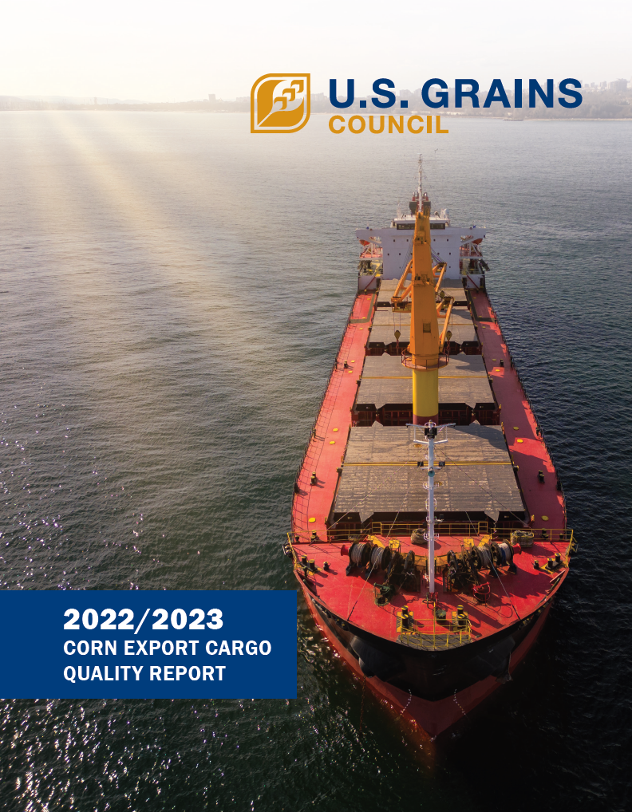
本报告其他部分 Other Components of the Report
品质检测结果 Quality Test Results
美国玉米出口系统 U.S. Corn Export System
调查和统计分析方法 Survey and Statistical Analysis Methods
检测分析方法 Testing Analysis Methods
历史角度 Historical Perspective
Notes:
The Corn Export Cargo Quality Report includes these additional sections that I will not review in detail today. These sections are in the published report, and I will be happy to answer any questions you may have about them.

Slide 24
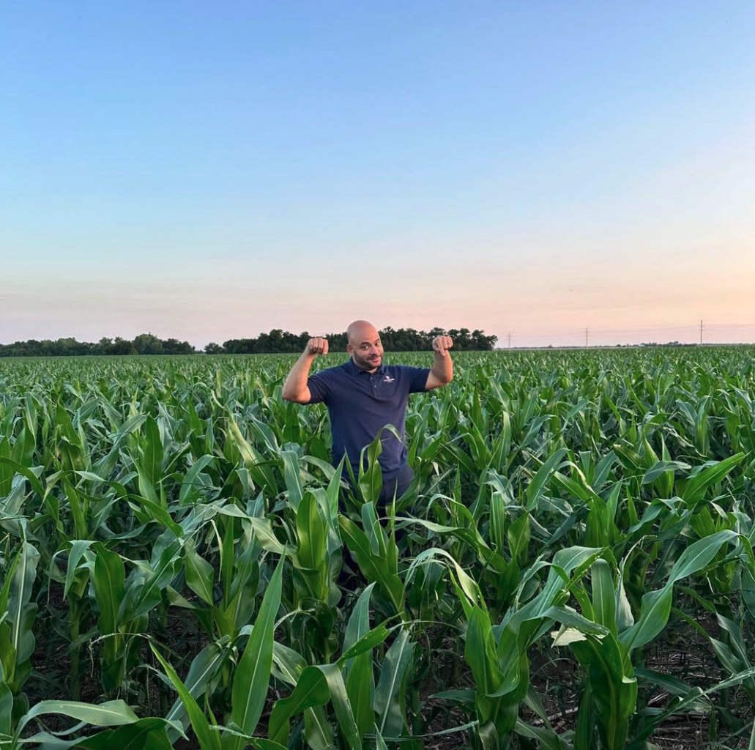
建立传统Building a Tradition
谢谢
Thank You!
Notes:
That is a summary of the U.S. Grains Council 2022/2023 Corn Export Cargo Quality Report. This completes the twelfth year of an annual series of corn quality reports for our export customers.
We are committed to continuing this report and the related Harvest Quality Report each year. We are continuing to build onto the foundation of this ongoing systematic survey of U.S. corn crop quality.
Our goal with these reports is to build the confidence of our export customers in the availability and quality of U.S. corn, and to reaffirm the commitment of U.S. corn producers to their export customers.
If you have any recommendations for how we can improve the usefulness of this report, please share your comments with us. We look forward to receiving your feedback.

