Slide 1

澳亚牧场热应激管理
AustAsia Farm Heat Stress Management
张海成
Jun 2025

Slide 2


澳亚集团存栏规模
AustAsia Group Herd Size
内蒙区域奶牛场
Inner Mongolia Dairy Farms
山东区域奶牛场
Shandong Dairy Farms
CFAA - 泌乳牛存栏：5,619 总存栏：11,496
CAAA - 泌乳牛存栏：5,681 总存栏：11,110
TXAA - 泌乳牛存栏：5,785 总存栏：11,468
内蒙区域泌乳牛总存栏为17,085；总存栏为34,074头。
Inner Mongolia milking cow herd is 17,085 hds; whole herd size is 34,074 hds.
DYAA - 泌乳牛存栏：5,318 总存栏：11,739
TAAA - 泌乳牛存栏：5,110 总存栏：9,535
DXAA - 泌乳牛存栏：5,432 总存栏：11,372
DSAA - 泌乳牛存栏：5,670 总存栏：12,151
XHAA - 泌乳牛存栏：5,231 总存栏：11,168
PS01 - 泌乳牛存栏：3,864 总存栏：8,624
PS02 - 泌乳牛存栏：3,865 总存栏：7,194
PS03 - 泌乳牛存栏：6,272 总存栏：16,394
山东区域泌乳牛总存栏为40,762；总存栏为88,177头。
Shandong milking cow herd is 40,762 hds; whole herd size is 88,177 hds.
山东&内蒙肉牛场
Shandong & Inner Mongolia Beef Farm
饲料加工厂 Feed Mill
DYAB - 总存栏：22,150
TXAB - 总存栏：13,557
山东&内蒙区域肉牛总存栏为38,075头。
Shandong & Inner Mongolia beef cattle herd is 38,075 hds.
截止到2024年12月31日，
集团总泌乳牛存栏为57,847头；总存栏为122,251头。
Till Dec 31st 2024,
AustAsia Group total milking cow herd is 57,847 hds; whole herd size is 122,251 hds.
AAFT - 设计年产：13万吨
AAFT – Yearly design Production: 130,000T
备注：数据统计日期2024年12月31日。
Notes: Data collected till Dec 31st 2024.

Slide 3
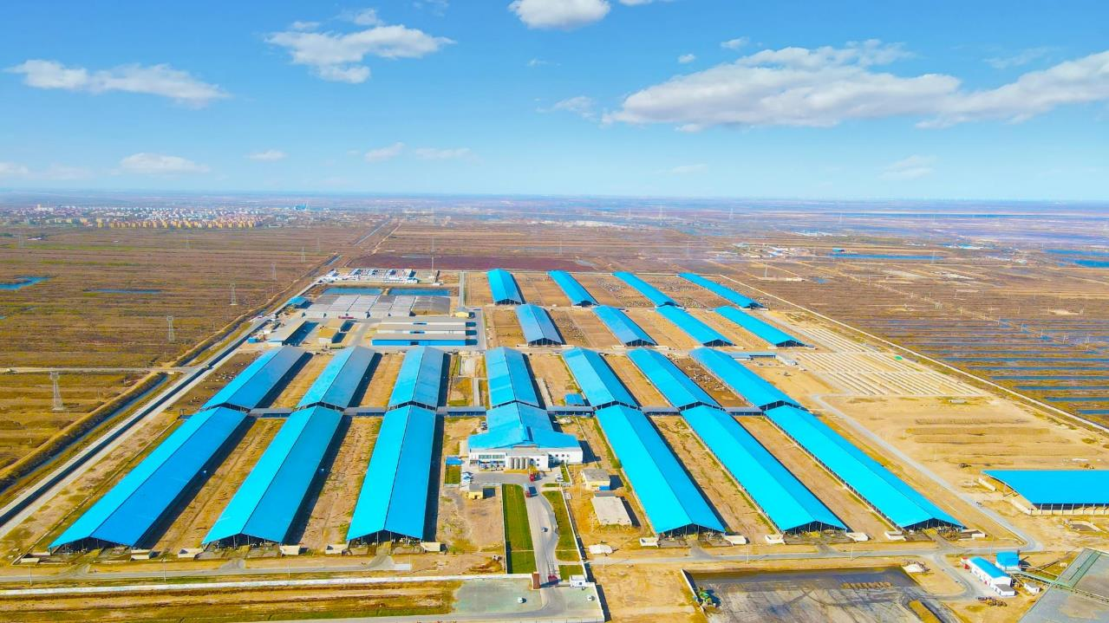
Farm4:DongYing Shenzhou AustAsia Modern Dairy Farm Co., Ltd

Slide 4
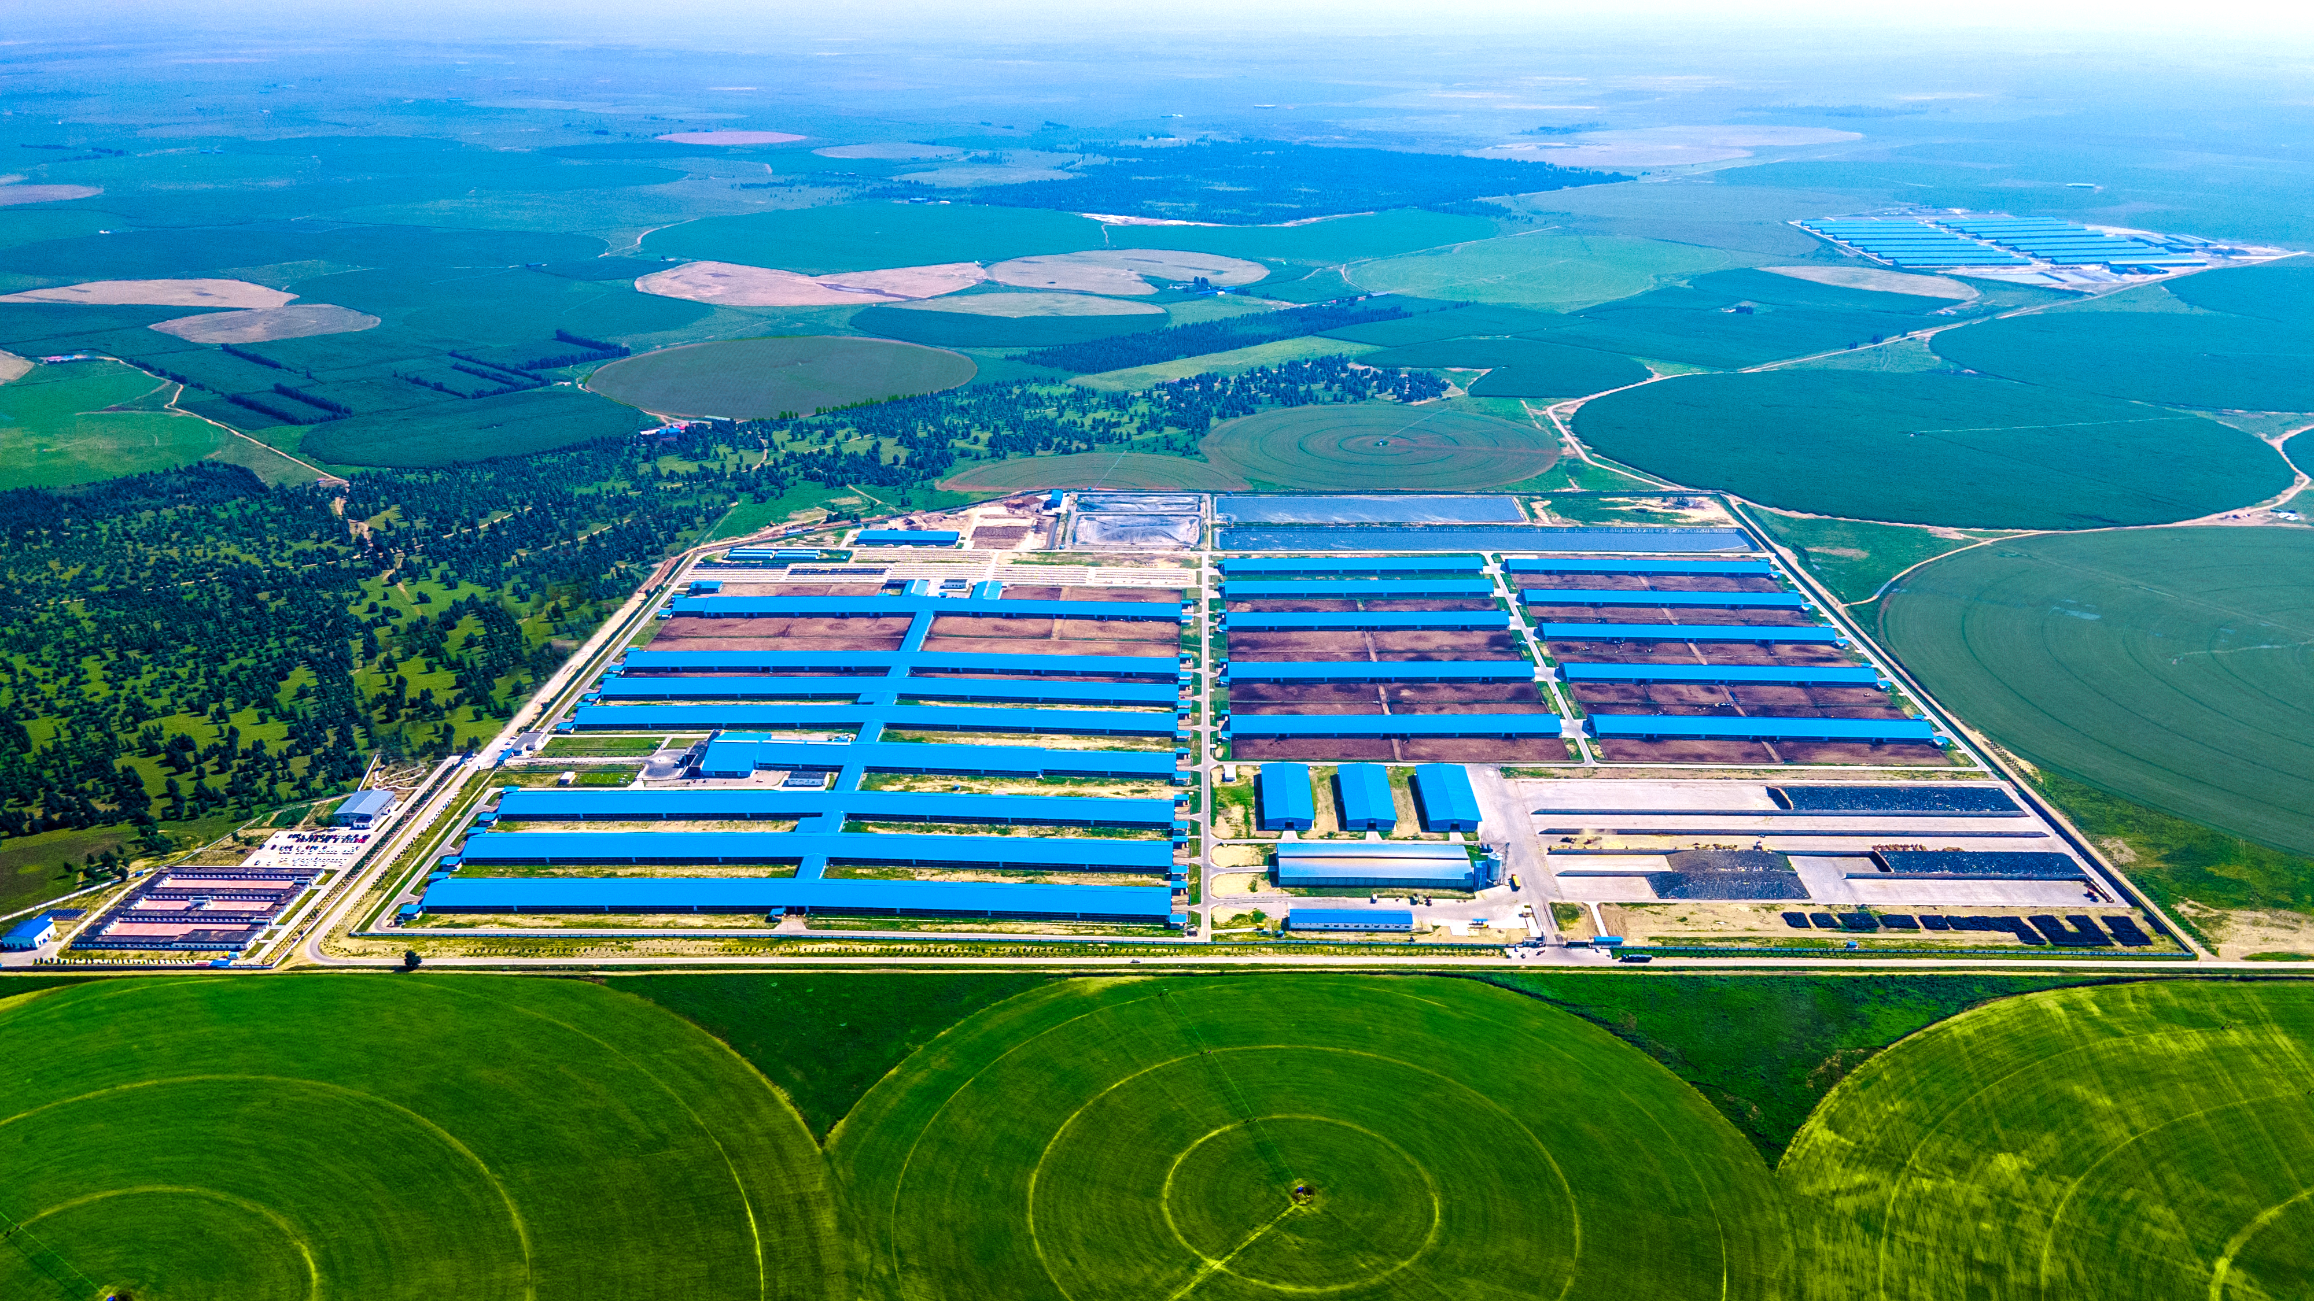
Farm8:ChiFeng AustAsia Modern Dairy Farm Co.,Ltd Tong xi Branch

Slide 5
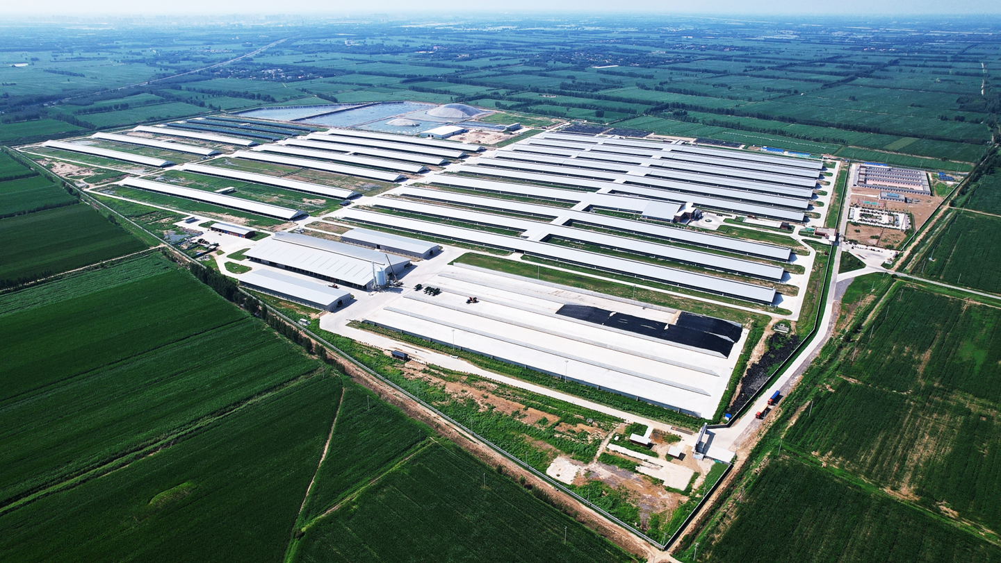
Farm11:Pure Source Dairy Farm Co., Ltd. Yanbei Branch

Slide 6
更高的产量
Higher ADM
饲养与营养
Feed & Nutrition
舒适度
Comfort
遗传育种
Genetics & Breeding
优质的粗饲料
High Quality Feed
后备牛
Heifers
一致性
Consistency
稳定的团队
Stable Team
健康管理
Health Management
牧场设计与建设
Farm design& construction
热应激
Heat Stress
冷应激
Cold Stress
卧床管理
Beds Management
转牛、夹牛时间、赶牛及声音等应激管理
Cattle move, headlock time, push and sound ect. Stress management

Slide 7
热应激定义
Heat Stress Definition
热应激的监控
Heat Stress
Supervision
如何缓解热应激
How to Release
Heat Stress
热应激影响
Heat Stress
Impact
总结
Summary
热应激-目录
Heat Stress-Content
1
2
3
4
5
什么是热应激
What is heat stress
温湿指数
THI
奶牛行为
Cows’ behavior
产奶量
Milk yield
繁殖
Reproduction
乳脂、乳蛋白、体细胞
Milk fat, CP and SCC
遮阳
Sun-shade
通风+水
Ventilation + Water
营养
Nutrition
每日监控
Daily Supervision

Slide 8
热应激定义—关于热应激
Heat Stress Definition – About Heat Stress
奶牛舒适温度范围为5-20度，对于泌乳牛最佳温度范围4.4-15.6度。
The comfortable temperature range for cows is between 5 to 20℃, while the optimal temperature range for lactating cows is between 4.4 to 15.6 ℃.
随着奶牛产量的增加，奶牛更容易受到热应激的影响；热应激阈值已有过去的THI 72下调到THI 68(产量>35Kg/天)。
As dairy cows’ milk production increases, they become more susceptible to heat stress; the threshold for heat stress has been lowered form a previous THI of 72 to a THI of 68 (for production >35 kg/day).
我们需要注意的是，适宜繁殖的THI临界值比适宜产量的THI临界值要低。
It is important to note that the THI threshold for optimal breeding is lower than that for optimal production.
根据University of Arizona的研究，THI≥65时，繁殖水平开始下降；THI ≥68时，产奶量开始下降。
According to research from the University of Arizona, reproductive performance begins to decline when THI ≥65, and milk production starts to drop when THI ≥68.
来自 Garcia-Ispierto et al., 2006的研究，THI≥55时，21-30天牛妊娠流失率开始增加。
From the study by Garcia-Ispierto et al., 2006, the loss rate of 21-30 day pregnancy begins to increase when THI ≥55.
也有资料提到，奶牛的代谢产热与采食量和产奶量有关，如今，奶牛具有更高的采食量和产奶量，因此代谢热的产生也较高。由于这些指标的增加，热应激阈值已降低至65℉（18.3℃)， 即THI=62时，产量大于等于45公斤的奶牛产量就开始减少了。
Some sources also mention that metabolic heat production in cows is related to feed intake and milk yield. Nowadays, with higher feed intake and milk production, cows generate more metabolic heat. Due to these increases, the heat stress threshold has dropped to 65℉ (18.3℃), meaning that when THI=62, milk production in cows yield ≥45kg begins to decline.
结论(Summary)：
1)温湿指数≥55 足以造成负面的繁殖影响；THI≥55 is enough to cause negative reproductive influence;
2)温湿指数≥62 产量≥45公斤的牛产量开始减少；THI≥62, can start milk loss for cows’ milk production ≥45kg ;
3)温湿指数≥65 繁殖水平开始下降，大多数奶牛开始产量减少；THI≥65 , reproductive performance begins to decline, can start milk loss for most cows;
4)温湿指数≥68 产量>35公斤的奶牛产量开始减少；THI≥68 can start milk loss for cows’ milk production >35kg;
5)随着产量不断提升、温湿指数（THI）在下降。 As production continues to increase, the THI declines.

Slide 9
热应激定义-THI
Heat Stress Definition – THI
温湿指数的计算，目前学术界比较认可Drackley等（2003）提出的计算方法
THI calculation is currently widely accepted in academic circles of Drackley’s proposed method(2003).
THI=td-(0.55-0.55×RH)×(td-58)
其中td为华氏温度，RH为相对湿度。Td is ℉,RH is relative humidity.
但考虑到华氏温度在国内不常用，我们参考文献，查得华氏温度与摄氏温度的转换公式为 5（F- 50°)= 9(C-10°)；我们转换公式，即得F=1.8C+32。
Considering ℃ is more commonly used in China, referred to the literature and found the conversion formula between ℉ and ℃ is 5（F- 50°)= 9(C-10°). So F=1.8C+32.
代入，THI=td-(0.55-0.55×RH)×(td-58)=1.8C+32-(0.55-0.55×RH)×[(1.8C+32)×RH] =0.81C+46.3+RH×(0.99C-14.3)
即：THI=0.81×摄氏度+(0.99×摄氏度-14.3)×相对湿度+46.3
2013-5-20日发布的《奶牛热应激评价技术规范》-NY/T 2363-2013
So, in conclusion: THI=0.81 x ℃+(0.99 x ℃-14.3) x RH+46.3
From The "Technical Specification for Evaluating Heat Stress in Cows" - NY/T 2363-2013(released on May 20, 2013).

Slide 10
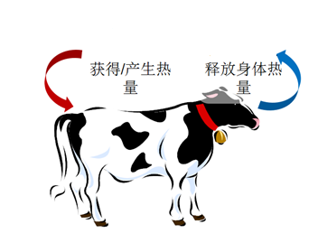
热应激的影响—奶牛行为
Heat Stress Impact – Cows' behavior
通常会寻找较为阴凉及通风的地方；
Usually will find shady and well-ventilated spots;
减少采食量；
Reduce feed intake;
增加饮水的次数和数量；
Increase the frequency and quantity of water intake;
更喜欢站着而不是躺着;
Prefers to stand rather than lie down;
发情时间减少及发情行为强度降低；
Decrease in-heat time and intensity of in-heat behavior;
降低体内器官中血液流动速率的同时，增加了血液在皮肤表层流动的速率;
While decreasing the rate of blood flow in the organs of the body, increaseing the rate of blood flow on the surface of the skin;
呼吸的速度加快；
Increase speed of breathing;
直肠的温度上升；
The temperature of the rectum rises;
这些现象和特征都说明奶牛在用它自己的调节方式来降低体热和向环境中释放热量。
These phenomena and characteristics indicate that the cow is using its own adjust method to reduce body heat and release heat into the environment.
Gain/produce heat
Release body heat

Slide 11
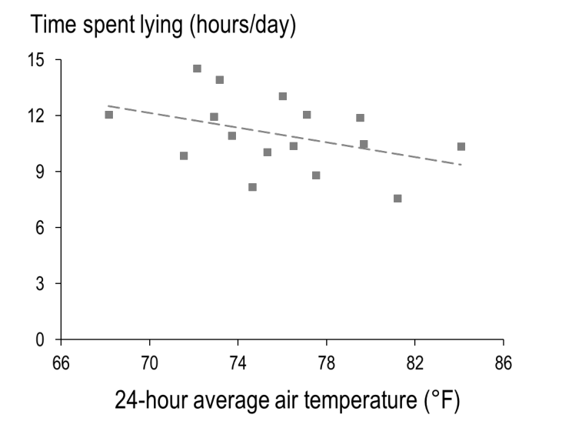
热应激的影响—奶牛行为
Heat Stress Impact – Cows' behavior
通常情况下奶牛的躺卧时间大于12小时，表明奶牛的舒适度良好；
Normally, if cows spend more than 12 hours lying down, it indicates good comfort levels;
热应激期间奶牛的躺卧时间大大降低；
Laying time in dairy cows is significantly reduced during heat stress;
产奶量 Milk yield
蹄病 Hoof disease
Chen (Van Os) et al., 2013, 2016,

Slide 12
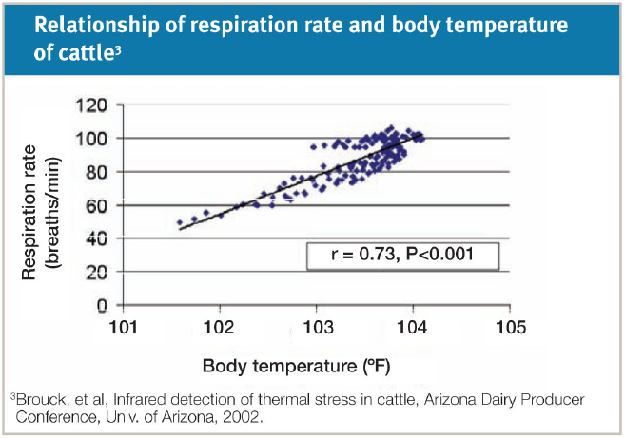
热应激的影响—奶牛行为
Heat Stress Impact – Cows' behavior
38.3°
38.9°
39.4°
40.4°
40.6°

Slide 13
热应激的影响—奶牛行为
Heat Stress Impact – Cows' behavior
不同温度和产量下，奶牛对饮水量的要求
Cows' water intake requirements at different temperatures and yields
产奶量 (公斤/日) Milk Yield(kg/day) | 当日最低气温(Cº) The lowest temperature of the day
 | 10 | 18 | 26 | 34
 | 饮水量(公斤/头/日) Water intake volume (kg/hd/day)
20 | 80 | 88 | 100 | 112
30 | 92 | 104 | 116 | 128
40 | 110 | 118 | 130 | 142
1、一样产量的情况下、温度越高饮水量增加。
Under the same production, higher temperatures lead to increased water intake.
2、产量越高饮水量越大。
The higher the yield, the greater the water consumption.

Slide 14

热应激的影响—产奶量
Heat Stress Impact – Milk Yield
影响热应激的还有热应激持续的时间，持续时间越长，结果越糟糕。
The duration of heat stress also affects the outcome; the longer it lasts, the worse the results get.
如果热应激持续24小时之内，影响相对较小。但如果超过48小时，产量就会受到严重影响。如果温湿指数超过68，72小时之后后果就非常严重了。
If heat stress persists within 24 hours, the impact is relatively minor. However, if it exceeds 48 hours, production will be severely affected. If the THI exceeds 68, the consequences become very severe after 72 hours.

Slide 15
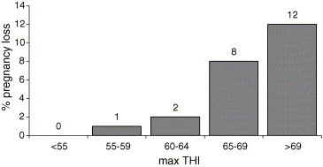
热应激的影响—繁殖
Heat Stress Impact – Reproduction
不同温湿指数对21～30天妊娠流失率的影响
Impact of Different THI on the 21-30 Day Pregnancy Loss%
(adapted from Garcia-Ispierto et al., 2006）
THI≥55时，对21～30天妊娠流失率的影响
When THI ≥ 55, the impact on the 21-30 days pregnancy loss%

Slide 16
热应激的影响—脂肪、蛋白、体细胞
Heat Stress Impact – Milk fat, CP and SCC
1、Fat 、CP夏季都明显走低；
Fat and CP levels both significantly decreased in summer.
2、SCC 从6月开始明显上升，10月份开始明显下降，逐步恢复正常水平；
SCC showed a significant increase starting from June, followed by a noticeable decline in October and gradually returning to normal levels.

Slide 17
如何缓解热应激—措施
How to release heat stress-Measures
遮阴 Sun-shade：
减少阳光直射、减少热量的产生。Reduces direct sunlight and heat generation.
通风 Ventilation：
最大限度的控制换气和风速是非常重要的,增加对流降温，加快换气速度，加快阴凉处牛体高度的空气流速.
Maximizing control over ventilation and wind speed is crucial, increasing convective cooling, accelerating the ventilation rate, and speeding up the airflow at cattle height in shaded areas.
通风能交换新鲜空气，排除牛舍牛舍二氧化碳、氨气、甲烷、颗粒、细菌等。
Ventilation can exchange fresh air and remove carbon dioxide, ammonia, methane, particles, bacteria, etc. from the cow barn.
通风可以将室外凉爽的空气（当室外空气温度低于奶牛体表温度时）替换室内温暖空气（大量奶牛聚集室温会升高）。
Ventilation can replace indoor warm air (which rises due to the congregation of numerous cows) with cooler outdoor air (when the outdoor air temperature is lower than the cows' body surface temperature).
水 Water：
增加饮水，补充因喘气和出汗而引起的呼吸和皮肤水分损失。
Increase water intake to compensate for respiratory and skin moisture loss caused by panting and sweating.
喷洒在牛背部的水（水温低于牛体表面温度）也会通过热交换带走一部分热量。
Water sprayed on the cow's back (with a temperature lower than the surface temperature of the cow) will also carry away some heat through thermal exchange.
风+水(增强蒸发降温能力) Wind + Water (Enhanced evaporative cooling capacity)
1）水压小时形成大水滴，洒在皮肤上直接给牛降温，喷淋洒在牛背部然后关闭喷淋，使水在下一轮喷洒之前蒸发。
When the water pressure is low, large droplets are formed to directly cool the cows by sprinkling on their skin. The sprinkler is turned off after spraying on the cow's back, allowing the water to evaporate before the next round of spraying.
2）水压大时形成水雾，可以降低微环境温度，间接的给牛降温，高湿环境下不适用。
When water pressure is high, it forms water mist, which can reduce the microenvironment temperature and indirectly cool the cows. However, this method is not suitable for high humidity environments.

Slide 18
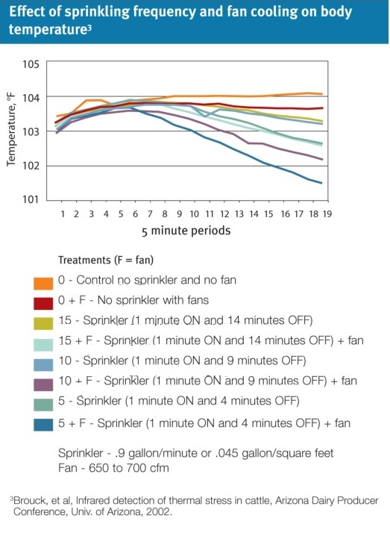
如何缓解热应激—措施
How to release heat stress-Measures
喷淋频次和喷淋、风机不同组合对直肠温度的影响
40.6°
结论 Conclusion：
1、在适当风机和喷淋的结合下，30-45分钟后体温开始下降，仅靠风扇无法降低体温。
Under the combination of appropriate fan and sprinkler, body temperature begins to drop after 30-45 minutes, if only depends on fans cannot reduce body temperature.
2、5分钟风机+喷淋（1分开）效果最好，在90分钟内体温下降到正常体温；
5 mins fan + sprinkler (1 min ON) has the best effect, body temperature drops to normal within 90 mins;
3、单独使用风机降温效果有下降，但不明显；
Only using fans has cooling effects but not obviously;
4、如果不能同时安装风机和喷淋，喷淋优先于风机；
If the fan and the sprinkler cannot be installed at the same time, the sprinkler takes precedence over the fan;
5、低压喷淋相对于单独使用风机更加有效；
Low-pressure sprinkler is more effective than using fans only;
6、增加喷淋的频率，更有利于快速的给牛降温；
Increase the frequency of spraying, which is more conducive to rapid cooling of cattle;
40.0°
39.4°
38.9°
30-45分钟
30-45 mins
38.3°
90分钟
90 mins

Slide 19
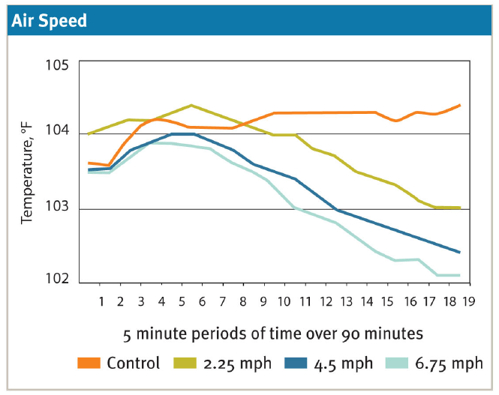

如何缓解热应激—措施
How to release heat stress-Measures
40.6°
每10分钟喷淋一次，在三种不同的风速下，测量直肠温度。
Spray every 10 minutes and measure rectal temperature at three different wind speeds.
结论 Conclusion：
4.5mph-6.75mph(2 m/s-3 m/s)持续风速结合喷淋获得最佳的降温效果
A sustained wind speed of 4.5mph-6.75mph (2 m/s-3 m/s) combined with sprinkler spraying achieves optimal cooling effects.
40.0°
1 m/s
39.4°
2 m/s
3 m/s
38.9°
1 m/s
2 m/s
3 m/s

Slide 20
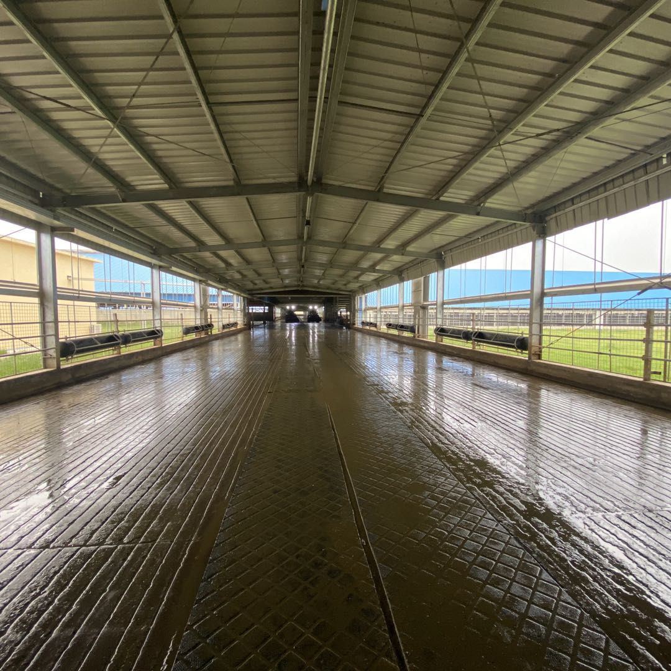
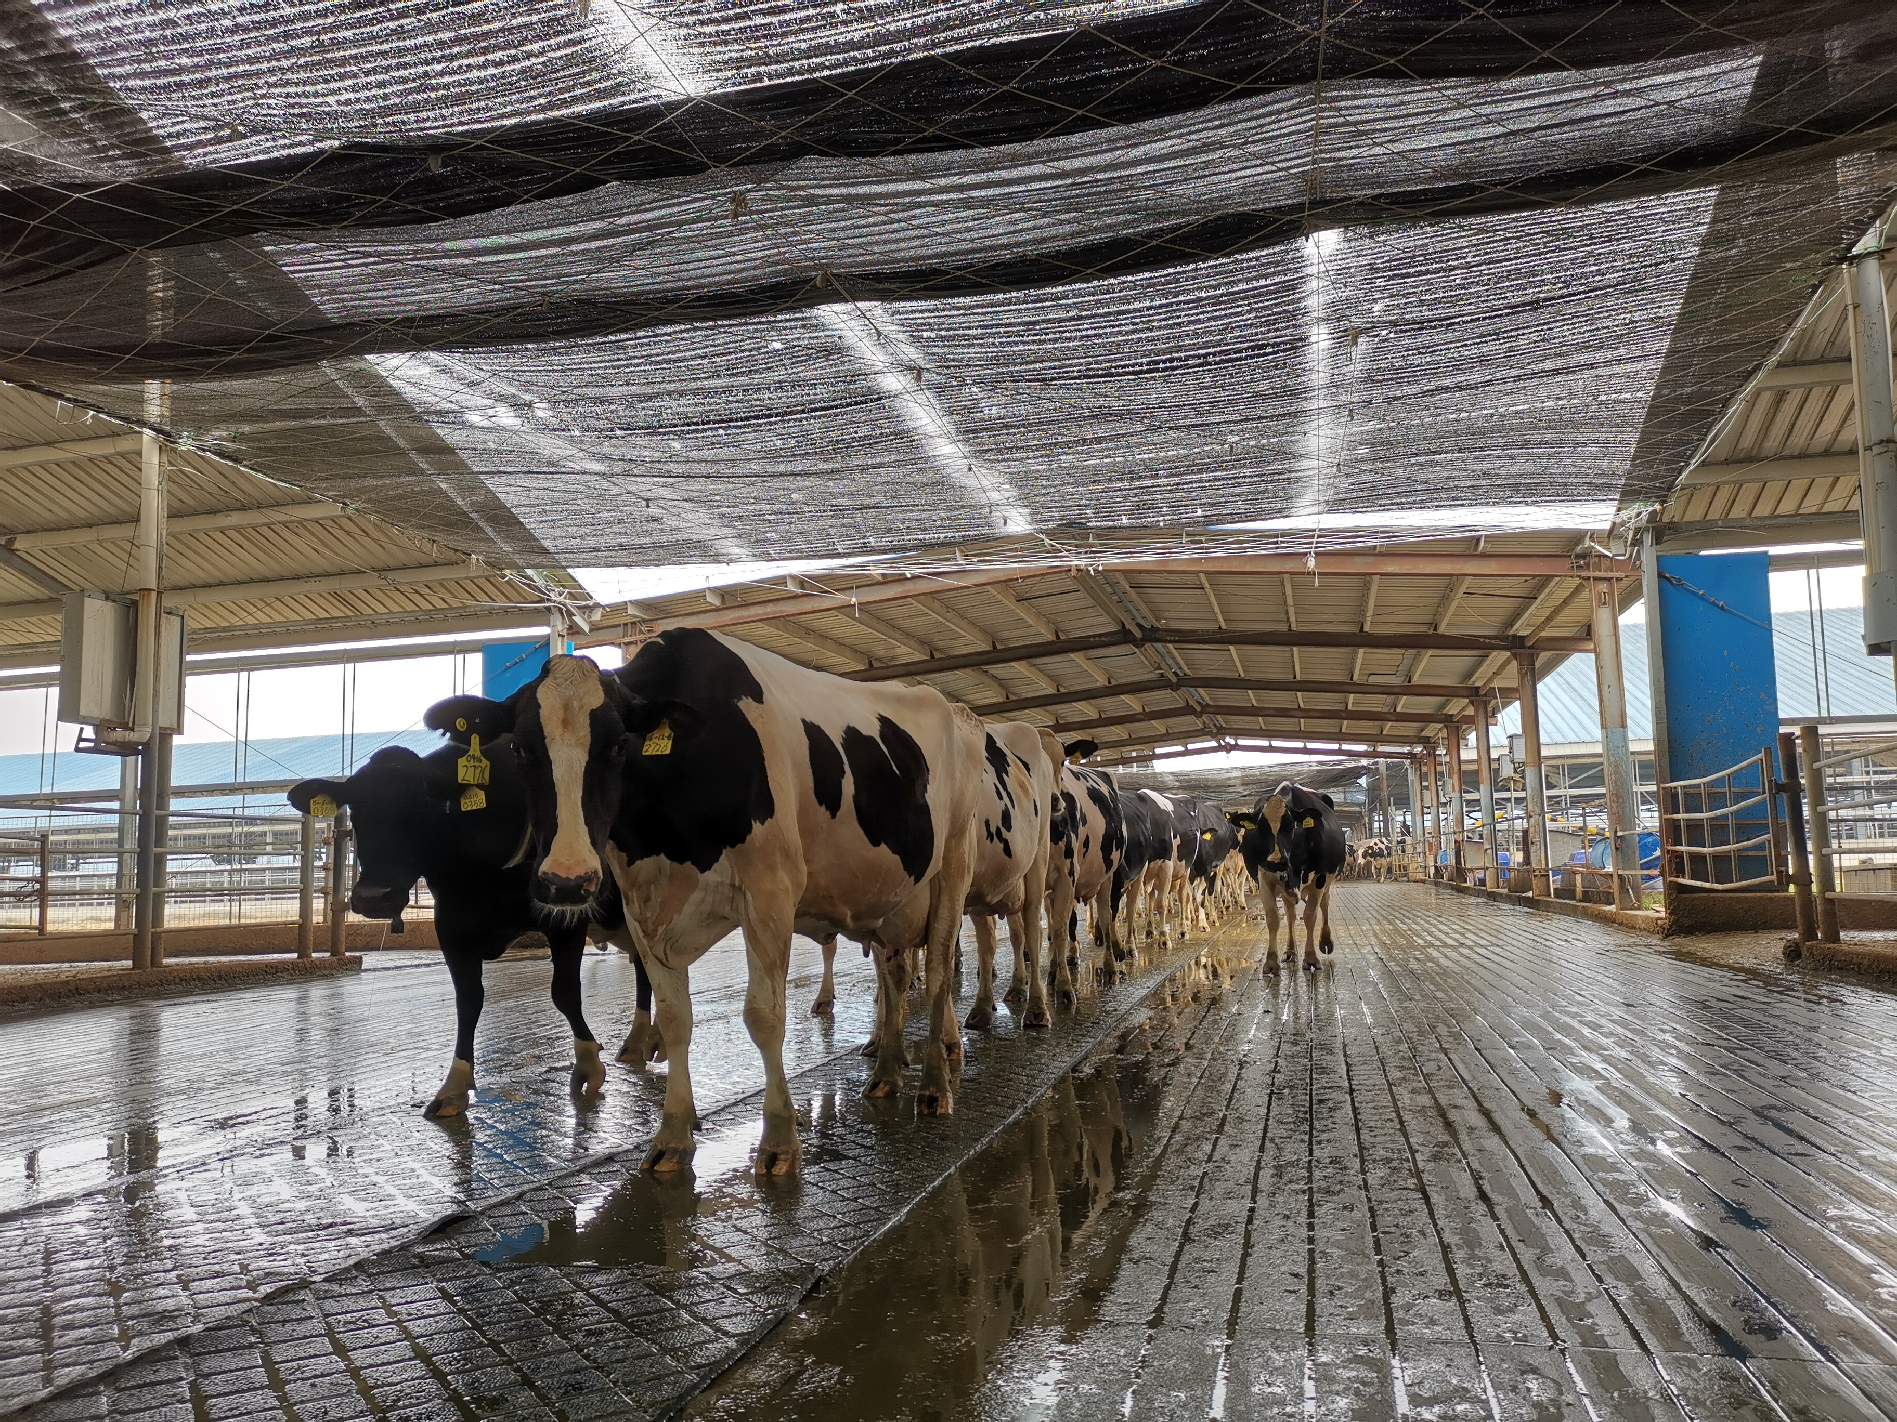
如何缓解热应激—遮阴
How to release heat stress-Sun-shade
遮阴的目的是为了减少奶牛的热辐射，如果没有遮阳，散热措施会大打折扣
The purpose of sun-shade is to reduce heat radiation for cows. Without sun-shade, heat dissipation measures would be significantly compromised.

Slide 21
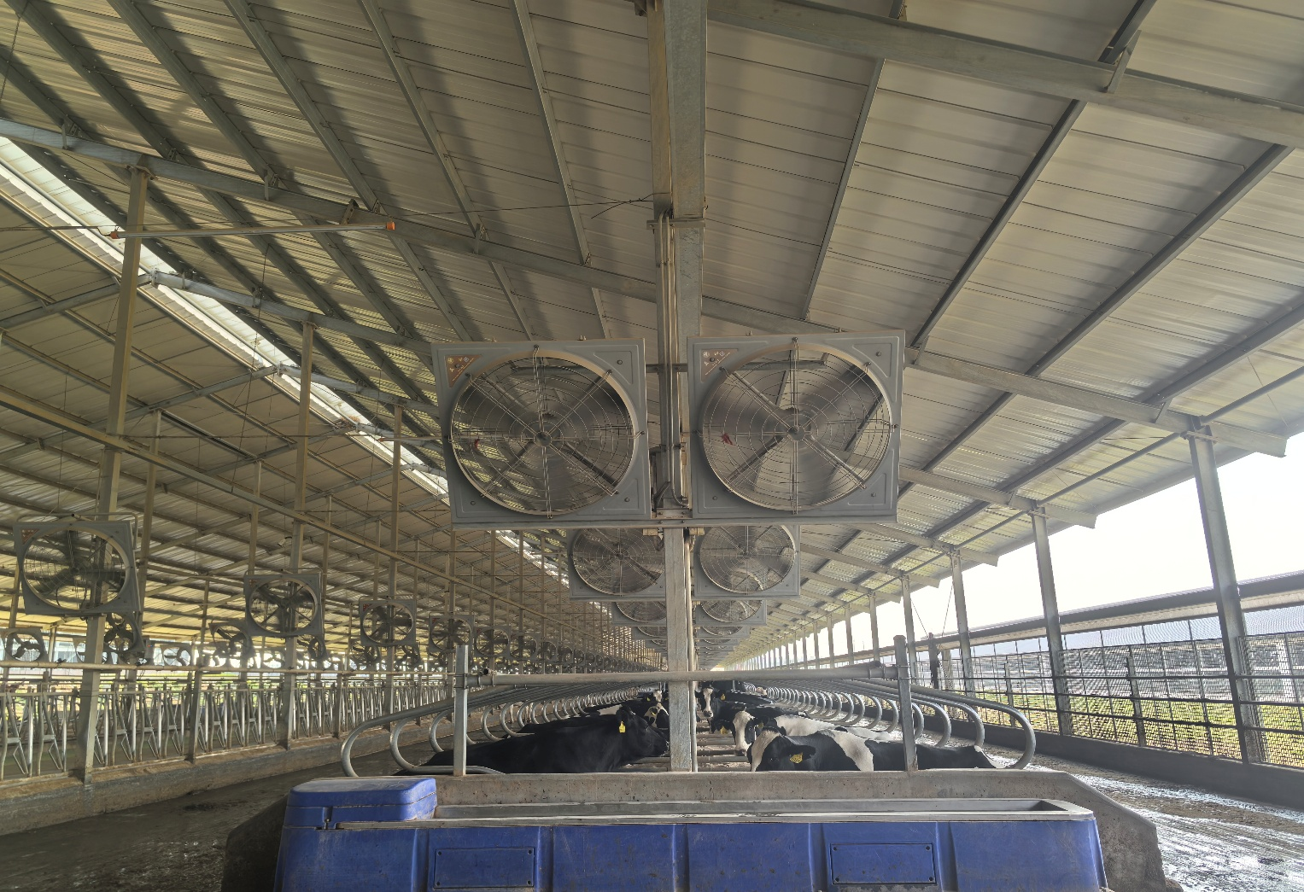
如何缓解热应激—通风
How to release heat stress-Ventilation
通过开放侧面、棚顶、边沿以及使用风机增加空气流通量
By opening side panels, roof panels, edges and using fans to increase air circulation.
饲喂道和卧床风扇的安装 Fan installation on feed lane and beds：
每个牛位大约需要风量:1360---1530立方米/每小时
Approximate air volume per bed: 1360---1530 cubic meters per hour
风机间距 Fan spacing:
卧床用48”风机为(7.3米---10.9米)，每6米安装1个；
48" fans for bed (7.3 m --- 10.9 m), install one for every 6 m;
饲喂道36”风机为(6.1米---7.3米)，每6米安装1个；
36" fan for feed lane is (6.1 m --- 7.3 m), install one for every 6 m;
建议使用此风机，牛只会阻挡空气向下流动，风机的密度越大，会有更多的气流产生. Suggest to use this fan, the cattle will block the downward flow of air. The higher the density of the fan, the more airflow will be generated.
风机安装高度 Fan height:
风机最低安装高度2.4米,在不影响牛只与设备的情况在较低位置安装;
The minimum installation height of the fan is 2.4 m, and should be installed in a lower position without affecting the cattle and equipment.
注意风机应位于喷淋上方. Fans should be located above the sprinkler.
风机安装角度:风机向下倾斜15-30度（冲相邻风机的底部）
Fan angle: 15-30 degrees downward tilt of the fan (towards the bottom of the adjacent fan)
双排自由卧床安装在中部上方，单排卧床安装栏位上方。
Double-row free beds are installed above the middle and single-row beds are installed above the beds.
风机朝向盛行风向。
Fans are oriented towards the prevailing wind direction.
产品型号 Product Model | 电源 Power Supply | 风量(m³/h) Air Flow (m³/h) | 功率(W) Power(W) | 6米平均风速(m/s) 6m Ave wind speed (m/s) | 重量kg Weight kg
QCHS-1000 | 3*380V 50hz | 21500 | 370 | > 3 | 28
EQCHS-1200 | 3*380V 50hz | 30500 | 400 | > 4 | 30

Slide 22
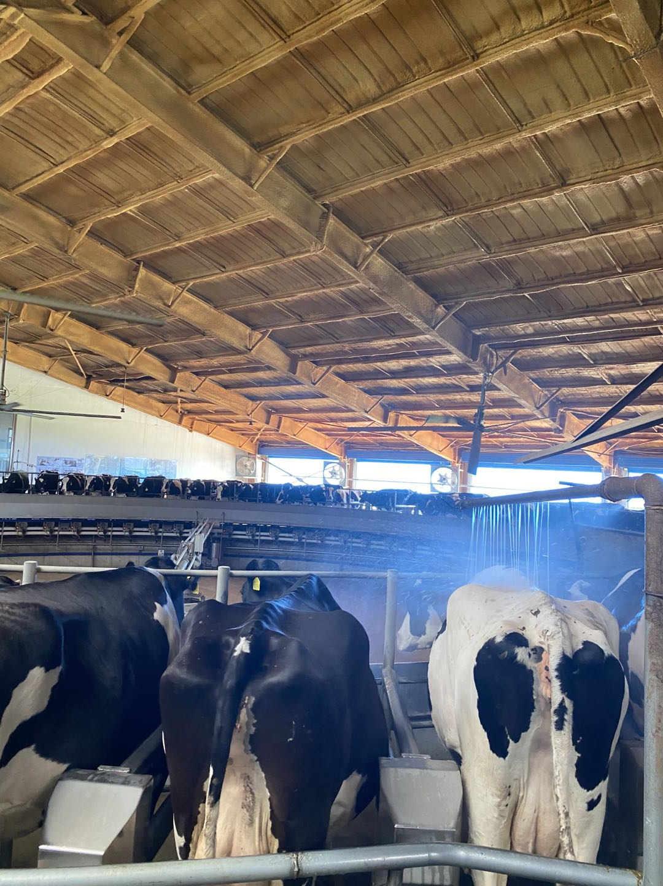
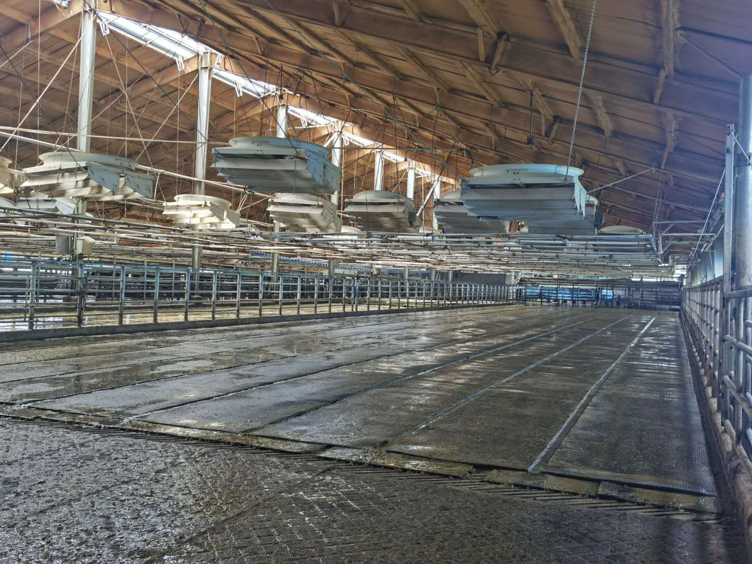
如何缓解热应激—通风
How to release heat stress-Ventilation

Slide 23
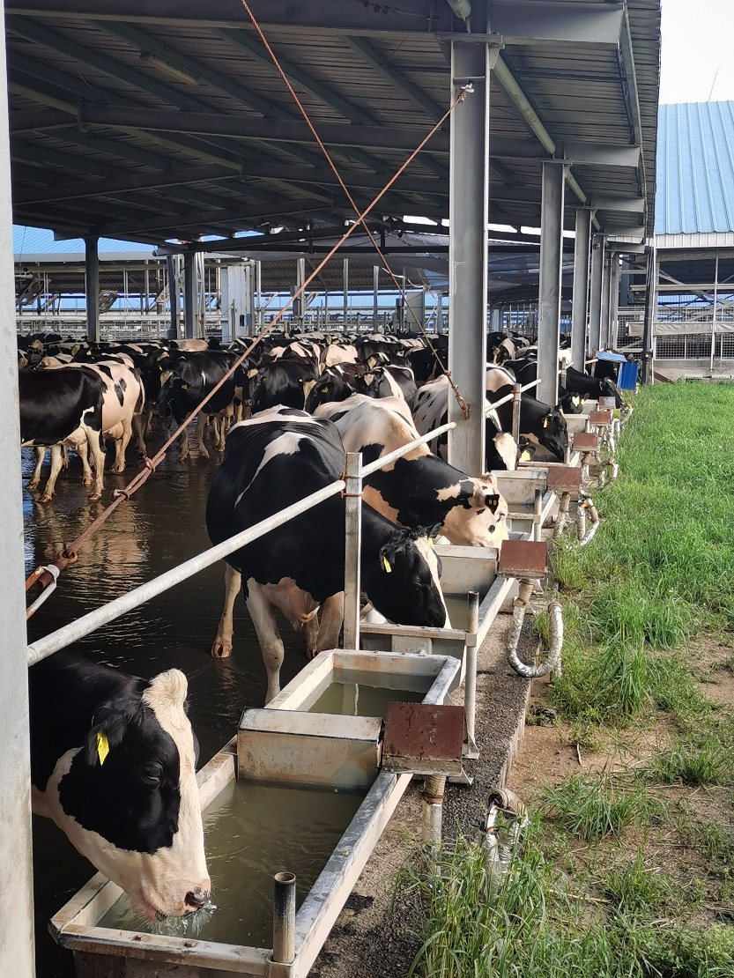
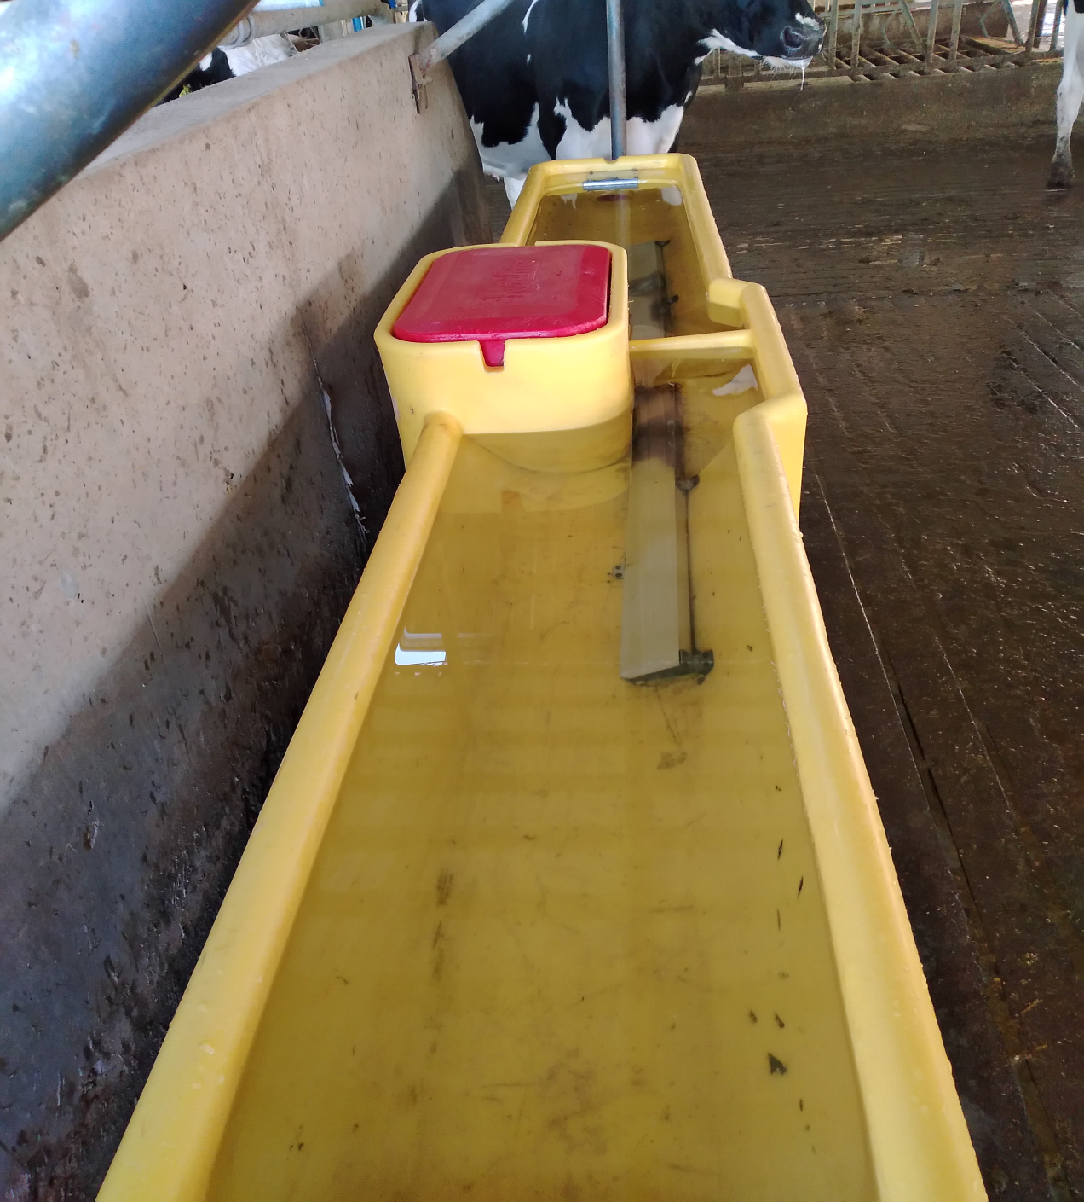
如何缓解热应激—水
How to release heat stress-Water
奶厅出口二侧加饮水槽，奶牛会消耗掉奶厅出口
日常饮水的30%
Adding water trough on both sides of the milking parlor exit, cows consume 30% of the daily drinking water at the milking parlor exit
保证充足干净的饮水
Ensure an adequate supply of clean drinking water
关于水温的研究
A study on the temperature of the water
1990年一项研究对饮用10.5℃水和27.2℃水的奶牛的实验结果表明(Wilks等1990)，10.5℃水更有利于奶牛：饮水量增加了7.7%，干物质采食增加了3%，呼吸频率和直肠温度下降，产奶量增加4.8%。所以在室外饮水槽上搭建遮阴棚将有很好的饮水效果。
A 1990 study comparing the effects of drinking water at 10.5℃ and 27.2℃ on cows (Wilks et al., 1990) found that 10.5℃ water was more beneficial for cows: it increased water intake by 7.7%, dry matter intake by 3%, reduced respiratory rate and rectal temperature, and boosted milk production by 4.8%. Therefore, constructing shade structures over outdoor water troughs will significantly improve drinking effects.

Slide 24
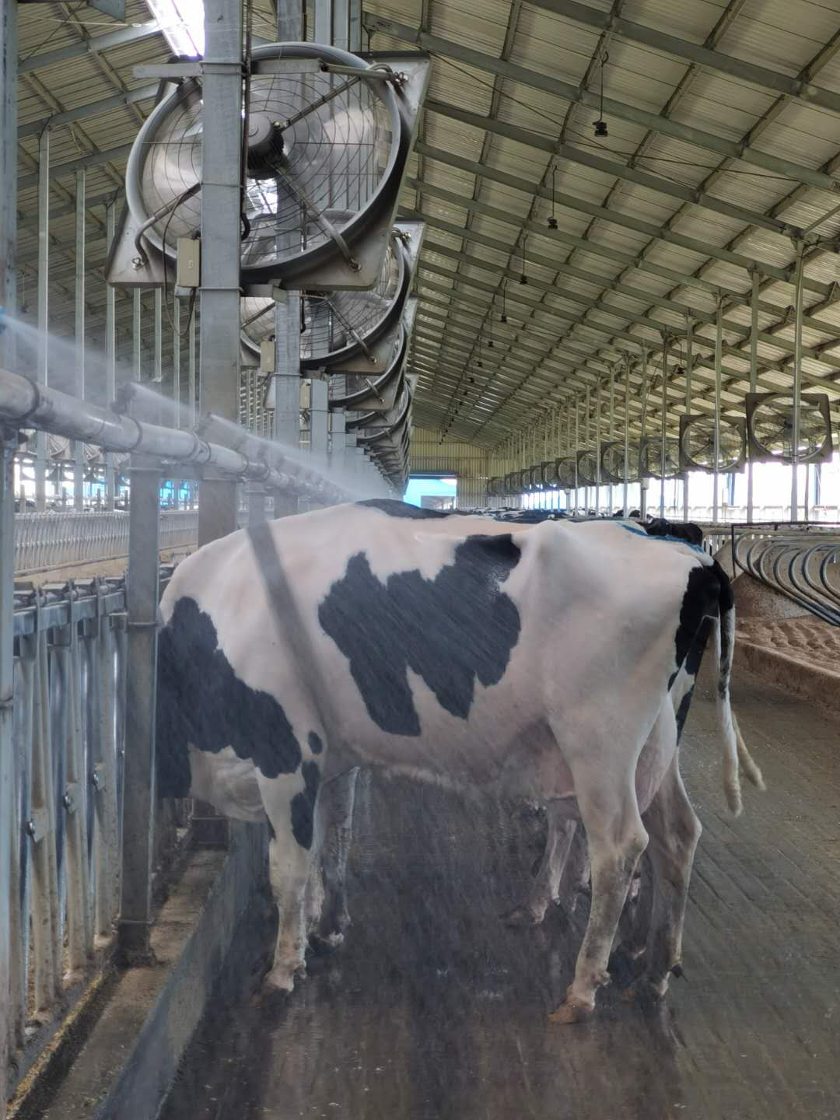
如何缓解热应激—水
How to release heat stress-Sprinkler
喷淋分低位安装和高位安装
Sprinkler systems can be installed at low or high positions
低位安装建议（1.52米-1.83米）Low positions suggest(1.52m-1.83m)
好处: 能够实现快速全面喷淋，较少的杂物堵塞喷头。
Advantage: include rapid and comprehensive spraying, as well as fewer obstructions from debris blocking the nozzles.
坏处: 喷头容易被牛破坏。
Disadvantage: the sprinkler system can be easily damaged by cattle.
高位安装建议（2.1米）Low positions suggest(2.1m)
好处: 在牛接触以外，不易被牛破坏。
Advantage: beyond cattle’s contact range which are not easily being destroyed.
坏处: 喷淋管线高风机吹来的杂物就越多。
Disadvantage: The higher the sprinkler line, the more debris is blown by the fan.
坏处: 喷淋安装过高管线内的水会洒到饲料上，会降低干物质采食量。
Disadvantage: Installing sprinklers at a high level may cause water to spill onto the feed in the pipeline, reducing dry matter intake.
喷头间距1.83米间距较为理想，2.1米间距更为节水。
An ideal sprinkler spacing is 1.83 meters, while a spacing of 2.1 meters is more water-saving.
喷淋应安装在颈夹内侧，最好与支柱隔开，防止水滴到矮墙。
The sprinkler should be installed on the inner side of the headlock, preferably separated from the pillar to prevent water droplets from falling on the low wall.

Slide 25
如何缓解热应激—风机和喷淋设置
How to release heat stress-Fans and Sprinkler Setting
位置 Area | 温度（摄氏度） Temperature (℃） | 喷淋时间（秒） Sprinkler on Duration (s) | 停止时间（分钟） Sprinkler off Duration (min) | 风机 Fans
奶厅 Milking parlor | 18-25 | 60 | 5 | 大于15度开风机 Temperature>15℃ - ON
 | ≥25 | 60 | 3
牛舍 Barns | 21-24 | 30 | 10 | 干奶、围产、新产、特需牛舍大于15度开风机，其它牛舍18度开风机 Dry-off, close-up, fresh, SN barn temperature>15℃ - ON; Other barns temperature 18℃ - ON
 | 25-27 | 30 | 5
 | ≥28 | 30 | 3

Slide 26
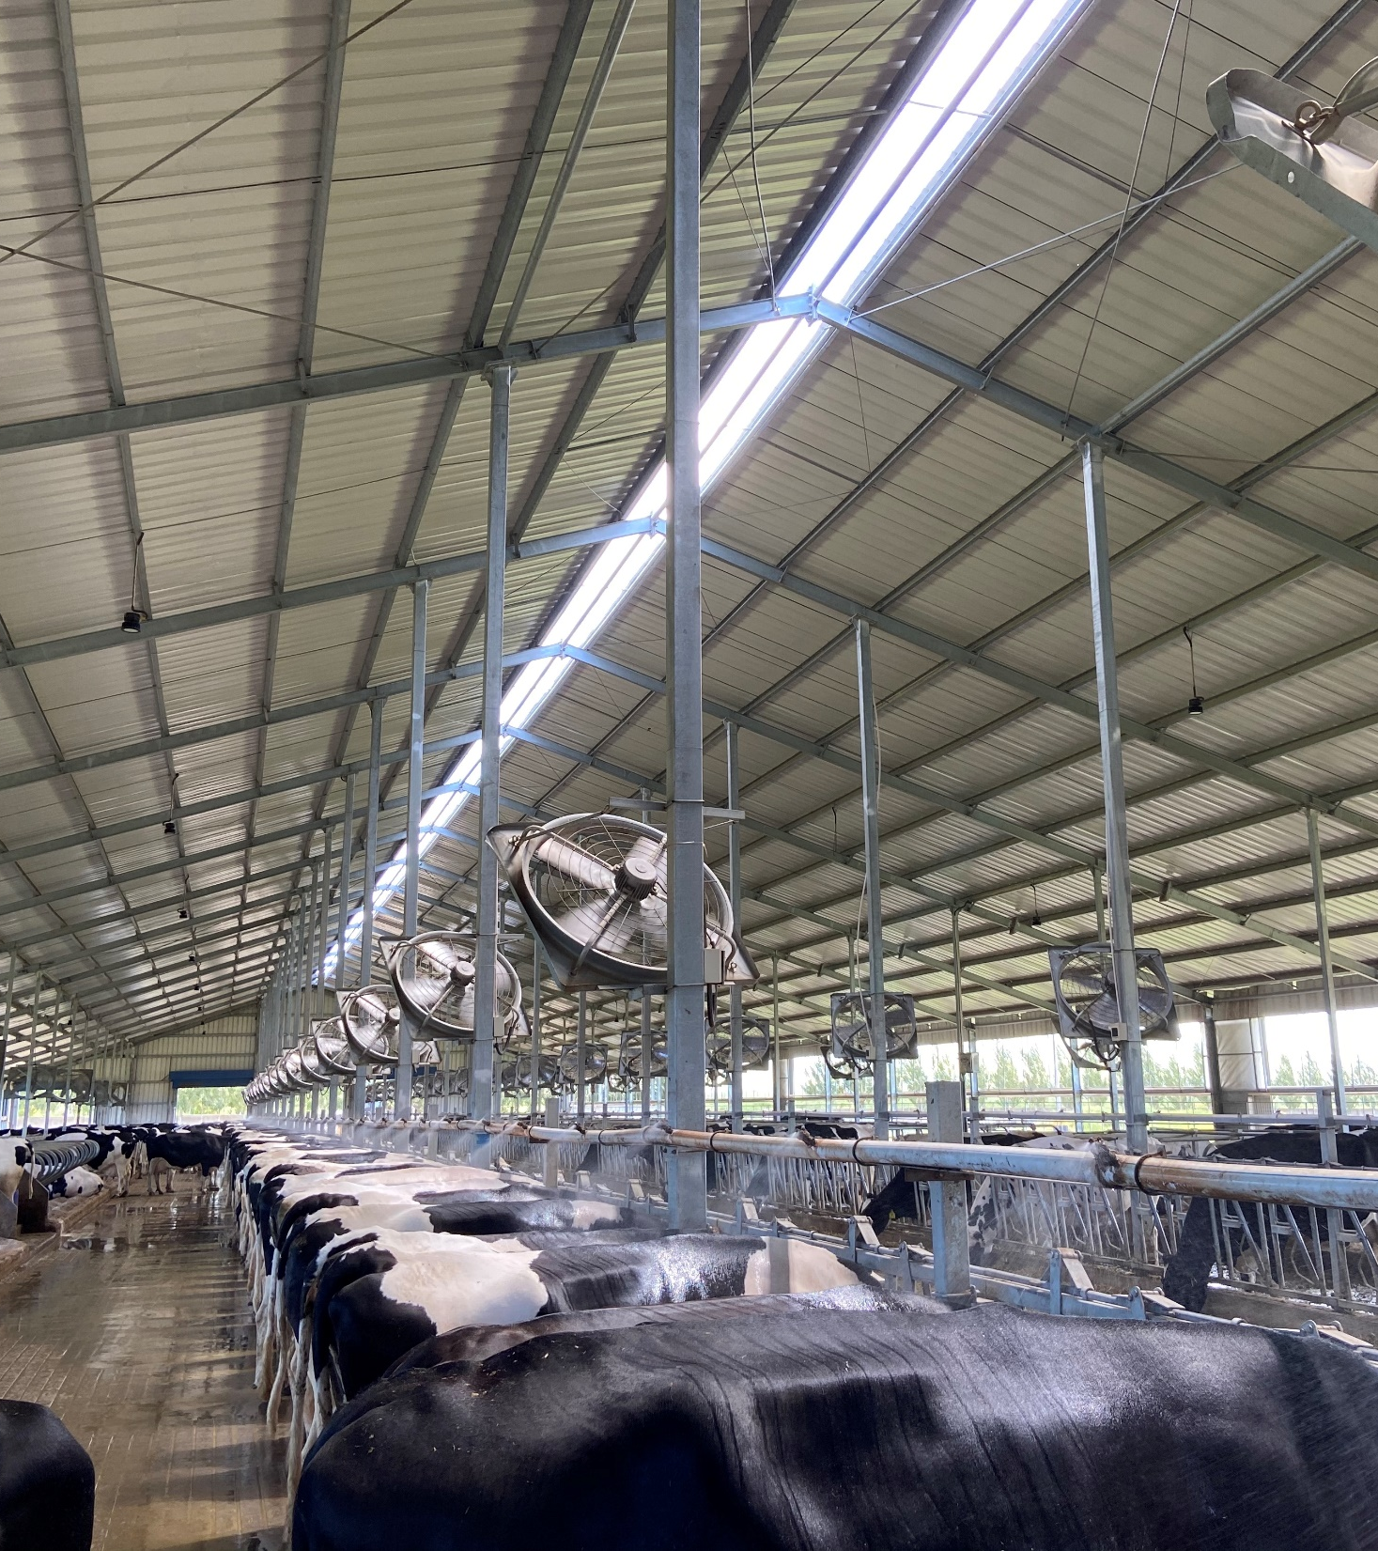
舒适度—热应激

Slide 27
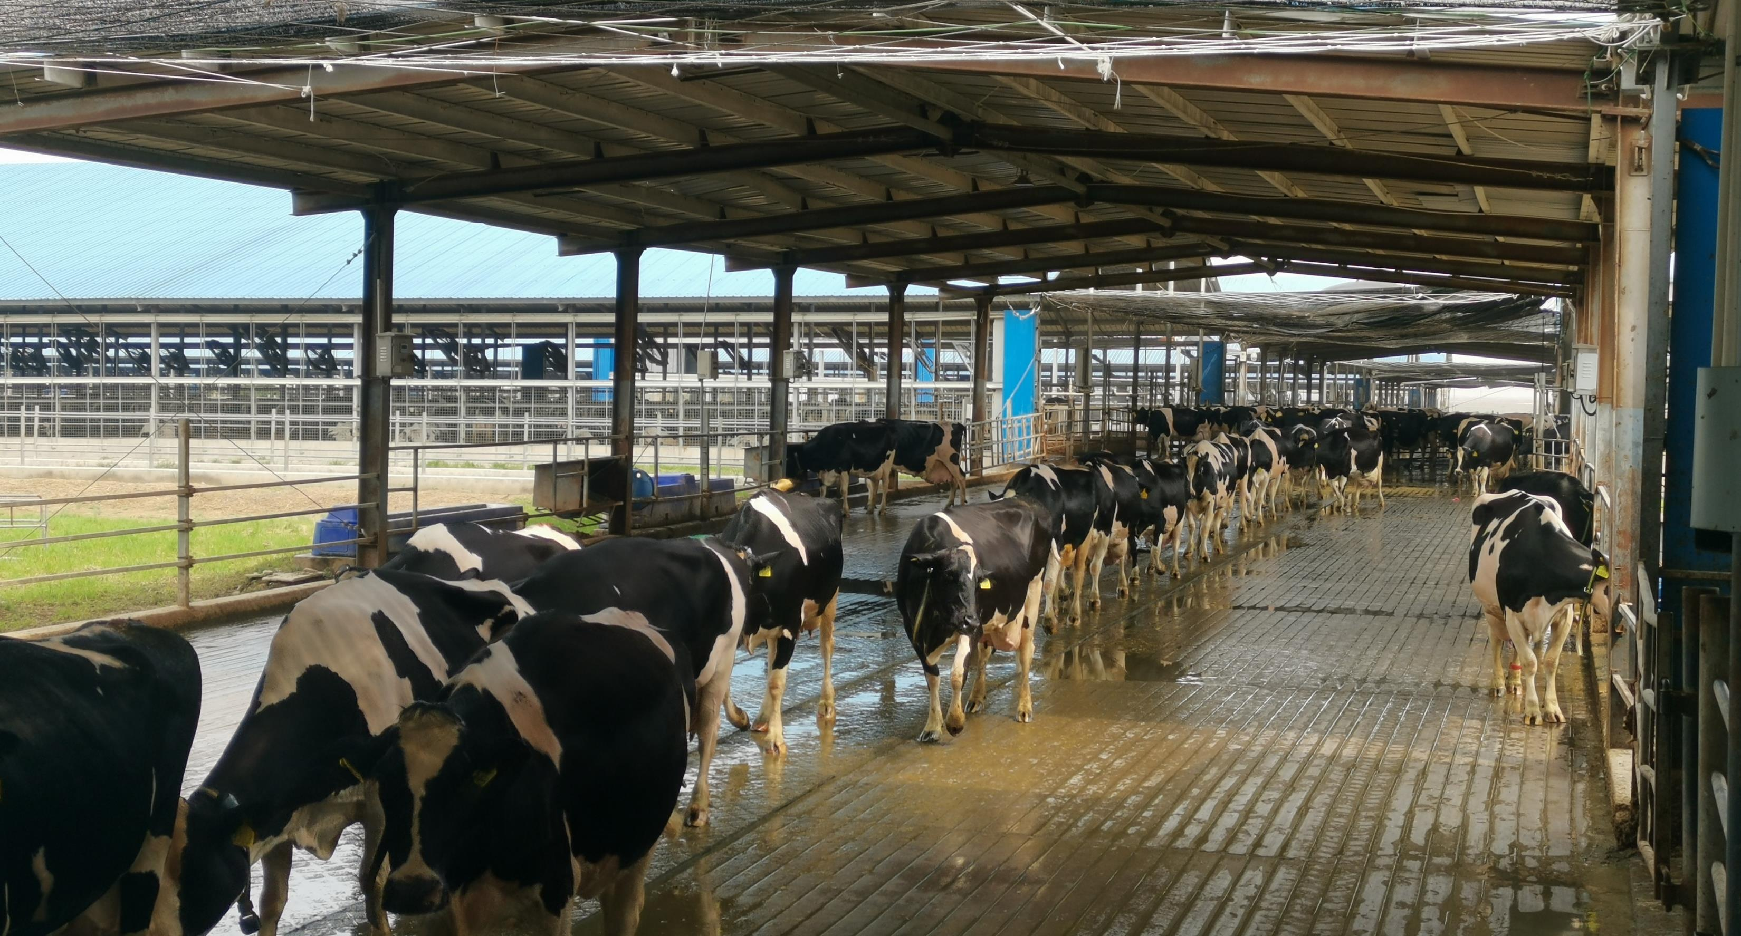

Slide 28
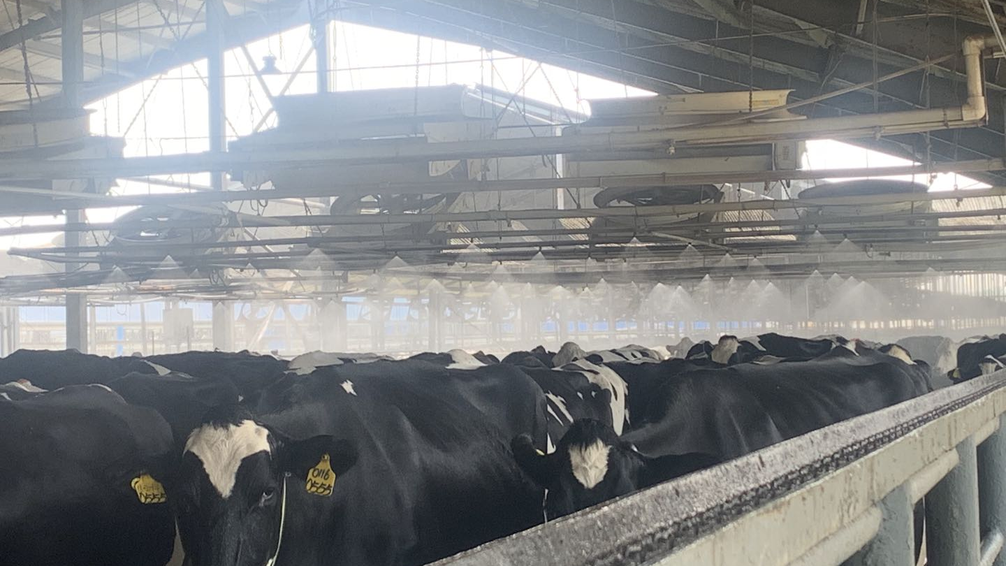

Slide 29
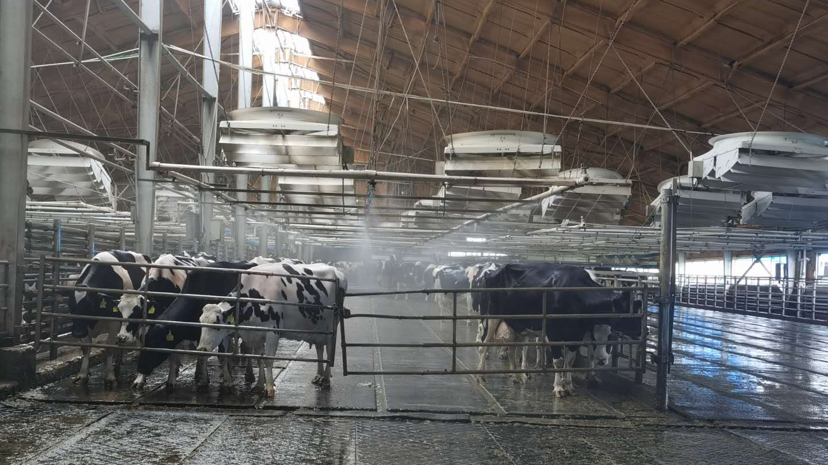

Slide 30
如何缓解热应激—营养
How to release heat stress-Nutrition
营养 Nutrition：
提高日粮营养浓度，如提高脂肪类的产品使用量。
Increase the nutritional concentration of the diet, such as by increasing the use of fat-based products.
使用纤维消化率高的粗饲料，最好苜蓿青贮和玉米青贮。
Utilize roughage with high fiber digestibility, preferably alfalfa silage and corn silage.
提高日粮DCAD水平,增加日粮配方中钾、钠水平。
Raise the DCAD level of the diet and increase the levels of potassium and sodium in the diet.
提高日粮配方里有机硒、维生素E的浓度抗氧化应激，功能性添加剂添加酵母或培养物、有机铬提高免疫力、缓解热应激。
Enhance the concentration of organic selenium and vitamin E in the diet to combat oxidative stress, and add functional additives like yeast or cultures, organic chromium to boost immunity and alleviate heat stress.
以及其它一些抗热应激产品，例如奥奶净等。
Also consider other heat stress-fighting products like OmniGen-AF.
在物理降温措施到位基础上强化热应激期间的营养管理。
On the basis of physical cooling measures, strengthen nutritional management during heat stress.

Slide 31
监控热应激—人工每日监控
Heat stress supervision-Manually & Daily Supervision
DXAA 热应激监控表 2025-5-11 DXAA Heat Stress Supervision Sheet 2025-5-11
日期 Date | 种类 Type | 牛舍 Barn | 牛号 ID | 记录时间 Record Time | 呼吸频率 RF | 均呼吸频率 Ave RF | 喘息评分 Breathing score | 均喘息评分 Ave Breathing score | 直肠温度 RT | 温湿指数 (THI) | 热应激程度 Heat Stress Level | 牛舍温度 Barn ℃ | 牛舍湿度 Barn Humidity | 水槽温度 Water Trough ℃ | 记录人 Recorder
上午 AM | 初产 Fresh | 15 | 336320 | 10:00 | 34 | 34.0 | 0 | 0 | 38.3 | 68 | 开始出现热应激 Starts heat stress | 23.4 | 42.1 | 19 | 邵宪锐
 |  |  | 336270 |  | 35 |  | 0 |  | 38.6
 |  |  | 336318 |  | 33 |  | 0 |  | 38.2
 |  |  | 336619 |  | 35 |  | 0 |  | 38.4
 |  |  | 336262 |  | 35 |  | 0 |  | 38.3
 | 高产 High Production | 19 | 316706 | 10:15 | 34 | 34.0 | 0 | 0 | 38.4 | 70 | 开始出现热应激 Starts heat stress | 24.2 | 40.5 | 17.8 | 邵宪锐
 |  |  | 325578 |  | 33 |  | 0 |  | 38.2
 |  |  | 326229 |  | 34 |  | 0 |  | 38.4
 |  |  | 302191 |  | 35 |  | 0 |  | 38.5
 |  |  | 316267 |  | 32 |  | 0 |  | 38.3
 | 干奶牛 Dry-off | 612 | 326837 | 10:25 | 33 | 33.0 | 0 | 0 | 38.5 | 67 | 热中性 Thermal neutral | 22.8 | 45.6 | 16.4 | 邵宪锐
 |  |  | 300887 |  | 35 |  | 0 |  | 38.6
 |  |  | 392236 |  | 35 |  | 0 |  | 38.3
 |  |  | 316033 |  | 32 |  | 0 |  | 38.5
 |  |  | 326021 |  | 32 |  | 0 |  | 38.2
 | 围产牛 Close-up | 509 | 316957 | 10:40 | 34 | 34.0 | 0 | 0 | 38.7 | 67 | 热中性 Thermal neutral | 22.6 | 43.6 | 20.2 | 邵宪锐
 |  |  | 316983 |  | 34 |  | 0 |  | 38.5
 |  |  | 326113 |  | 35 |  | 0 |  | 38.5
 |  |  | 315983 |  | 32 |  | 0 |  | 38.6
 |  |  | 325844 |  | 32 |  | 0 |  | 38.4
日期 Date | 种类 Type | 牛舍 Barn | 牛号 ID | 记录时间 Record Time | 呼吸频率 RF | 均呼吸频率 Ave RF | 喘息评分 Breathing score | 均喘息评分 Ave Breathing score | 直肠温度 RT | 温湿指数 (THI) | 热应激程度 Heat Stress Level | 牛舍温度 Barn ℃ | 牛舍湿度 Barn Humidity | 水槽温度 Water Trough ℃ | 记录人 Recorder
下午 PM | 初产 Fresh | 15 | 336364 | 14:00 | 43 | 43.0 | 1 | 1 | 38.2 | 74 | 轻度-中度热应激THI Mild-Moderate heat stress THI | 27.5 | 40.4 | 27.5 | 王亚同
 |  |  | 336174 |  | 44 |  | 1 |  | 38.4
 |  |  | 336114 |  | 42 |  | 1 |  | 38.5
 |  |  | 336366 |  | 42 |  | 1 |  | 38.5
 |  |  | 336333 |  | 43 |  | 1 |  | 38.3
 | 高产 High Production | 19 | 325319 | 14:10 | 42 | 42.0 | 1 | 1 | 38.2 | 74 | 轻度-中度热应激THI Mild-Moderate heat stress THI | 28.2 | 39.6 | 17.1 | 王亚同
 |  |  | 325402 |  | 43 |  | 1 |  | 38.5
 |  |  | 303383 |  | 42 |  | 1 |  | 38.7
 |  |  | 325841 |  | 42 |  | 1 |  | 38.5
 |  |  | 391893 |  | 42 |  | 1 |  | 38.4
 | 干奶牛 Dry-off | 612 | 372363 | 14:20 | 43 | 43.0 | 1 | 1 | 38.3 | 74 | 轻度-中度热应激THI Mild-Moderate heat stress THI | 27.6 | 39.7 | 17.6 | 王亚同
 |  |  | 302539 |  | 43 |  | 1 |  | 38.2
 |  |  | 317270 |  | 43 |  | 1 |  | 38.6
 |  |  | 302237 |  | 42 |  | 1 |  | 38.3
 |  |  | 316680 |  | 42 |  | 1 |  | 38.2
 | 围产牛 Close-up | 509 | 315753 | 14:35 | 42 | 42.0 | 1 | 1 | 38.6 | 73 | 轻度-中度热应激THI Mild-Moderate heat stress THI | 27.4 | 40.2 | 16.3 | 王亚同
 |  |  | 326761 |  | 43 |  | 1 |  | 38.5
 |  |  | 302147 |  | 42 |  | 1 |  | 38.4
 |  |  | 317004 |  | 43 |  | 1 |  | 38.2
 |  |  | 325943 |  | 42 |  | 1 |  | 38.2

Slide 32
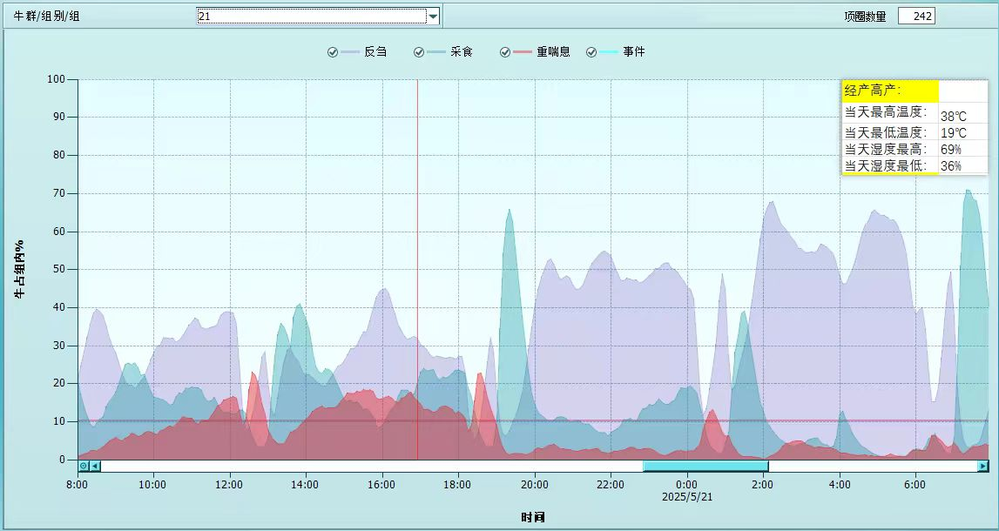
监控热应激—通过项圈每日监控
Heat stress supervision-Daily Supervise by Collar
Cow herd/group
Collar No
Ruminate
Intake feed
Heavy breath
Events
最低气温19°最高气温38°湿度36%-69% THI 63-92 ADM 57kg
Minimum temperature: 19°C, Maximum temperature: 38°C, Humidity: 36%-69%, THI: 63-92, ADM: 57kg
Percentage of cattle in the group
Time

Slide 33
热应激—总结
Heat stress-Summary
热应激对牧场效益产生严重影响
Heat stress has a serious impact on farm efficiency:
产奶量下降 ADM drop
繁殖率下降 Reproduction rate drop
乳脂、乳蛋白下降 Milk Fat & CP drop
犊牛出生体重下降 Calf BW drop
体细胞升高 SCC increase
蹄病升高 Hoof disease increase
乳房炎升高 Mastitis increase
代谢发病升高 Metabolic disease increase
免疫力减弱 Weakened immunity
死淘率增加 Culling & death% increase
等等------------------ so on…
缓解热应激最佳的方法
The best way to relieve heat stress:
遮阴-减少产热；
Sun-shade – reduce heat produce;
提供充足干净的饮水；
Provide adequate and clean drinking water;
风机+低压喷淋的方式增加散热；
Fans + low-pressure sprinkler to increase heat dissipation;
在物理降温措施到位基础上强化热应激期间的营养管理
On the basis of physical cooling measures, strengthen nutritional management during heat stress.
关注后备牛各个牛群的热应激
Monitor heat stress in heifer groups:
犊牛（通风+遮阴）
Calves (Ventilation + Sun-shade)
大胎怀孕青年（风机+喷淋）
Large DCC heifers (Fans + Sprinklers)
青年围产牛（风机+喷淋）
Close-up heifers (Fans + Sprinklers)

Slide 34
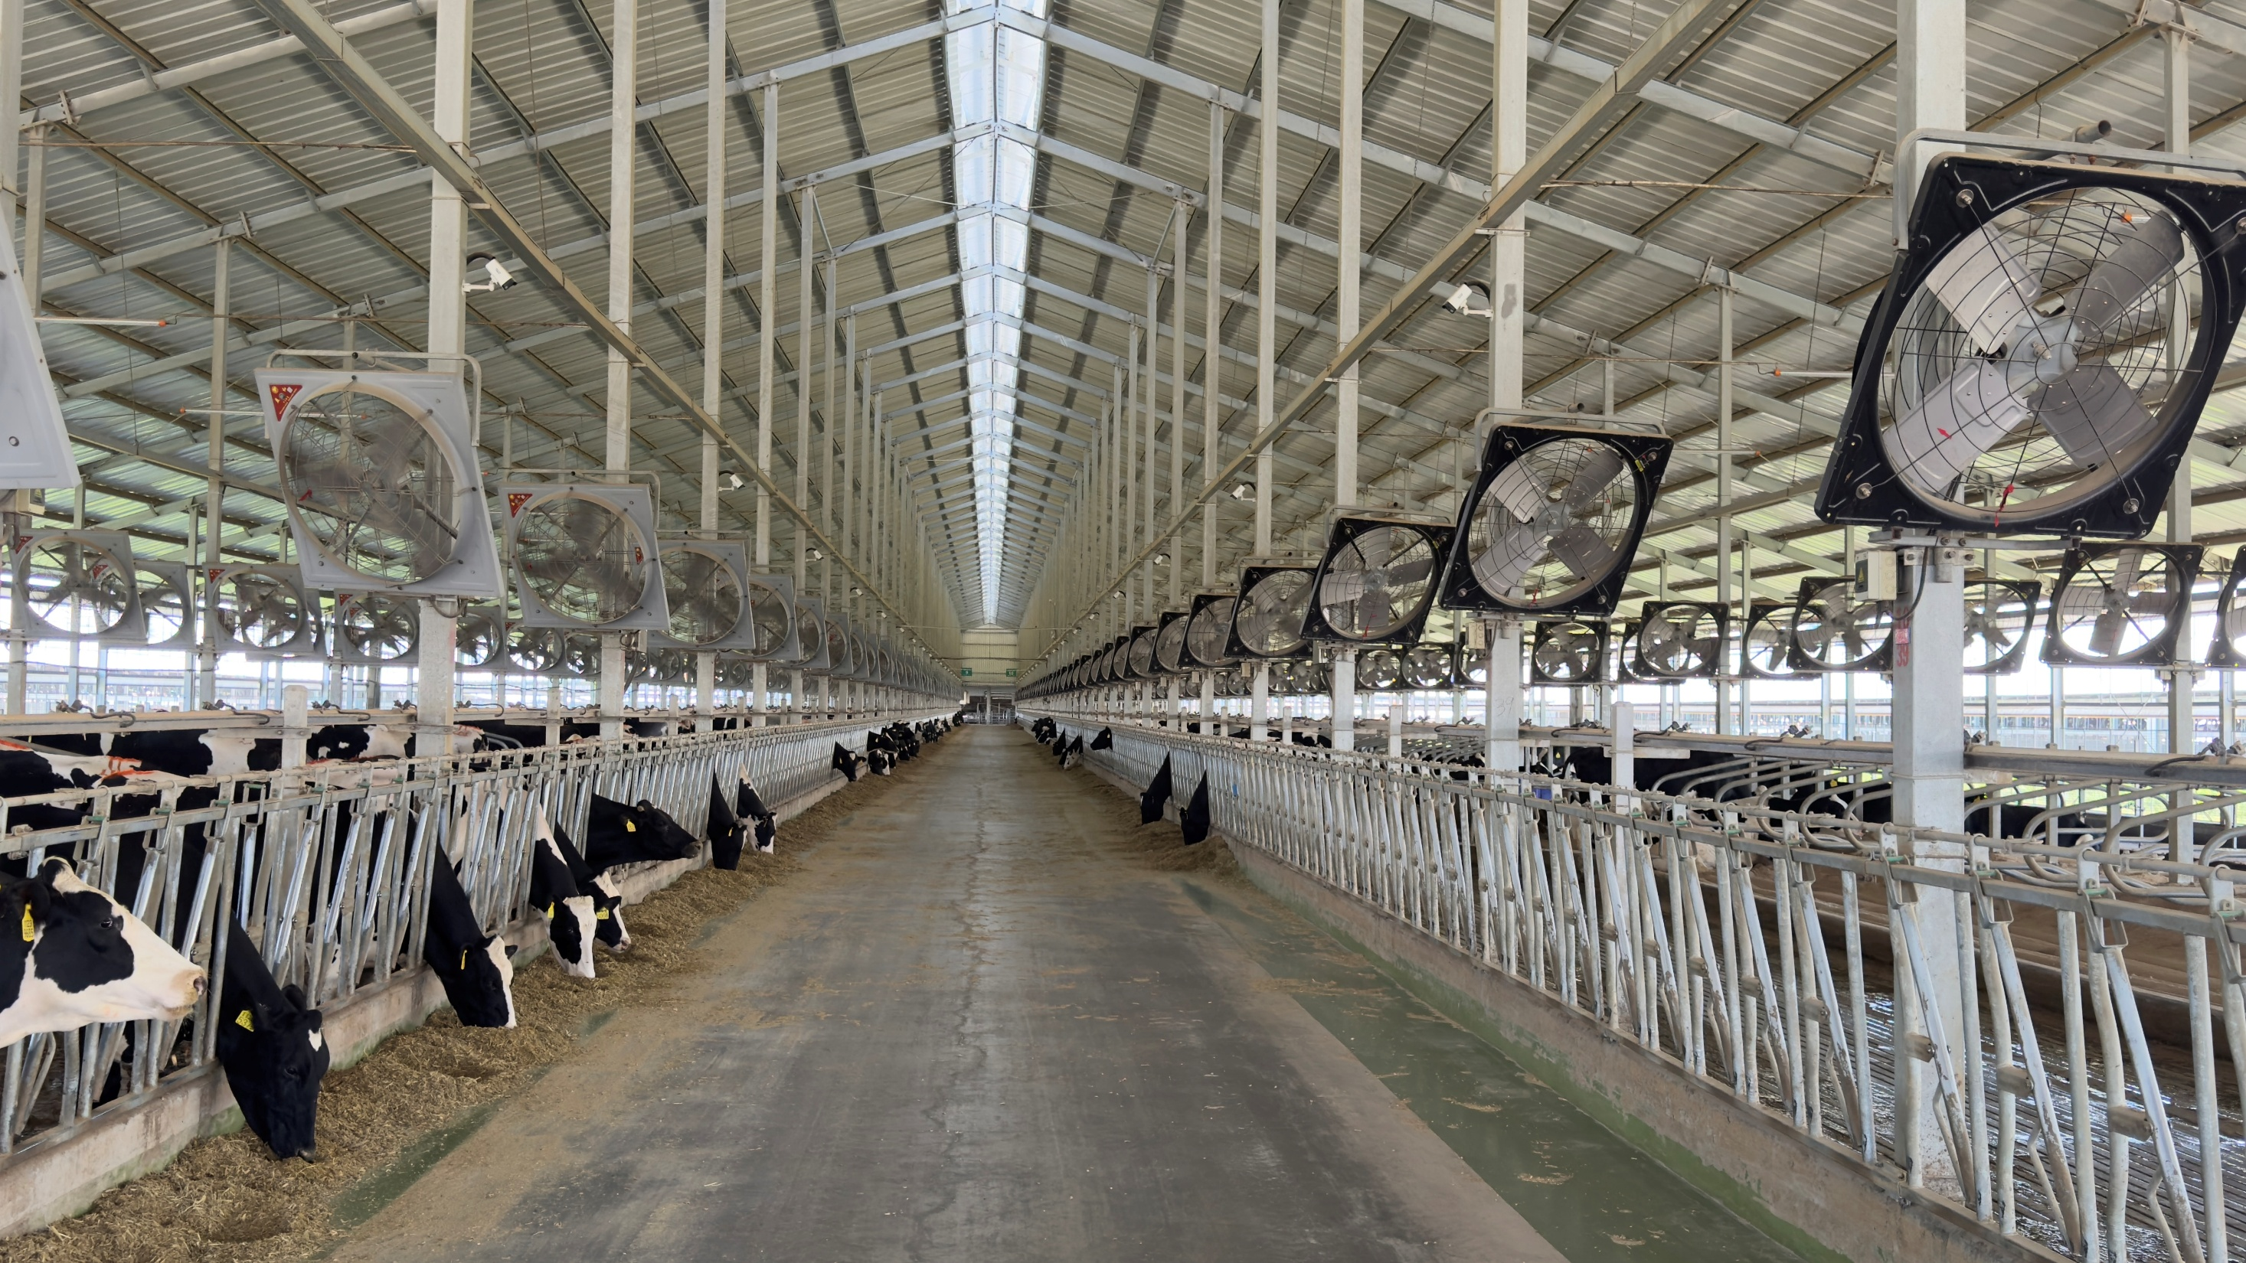
AI 智能喷淋
AI intelligent sprinkler

Slide 35

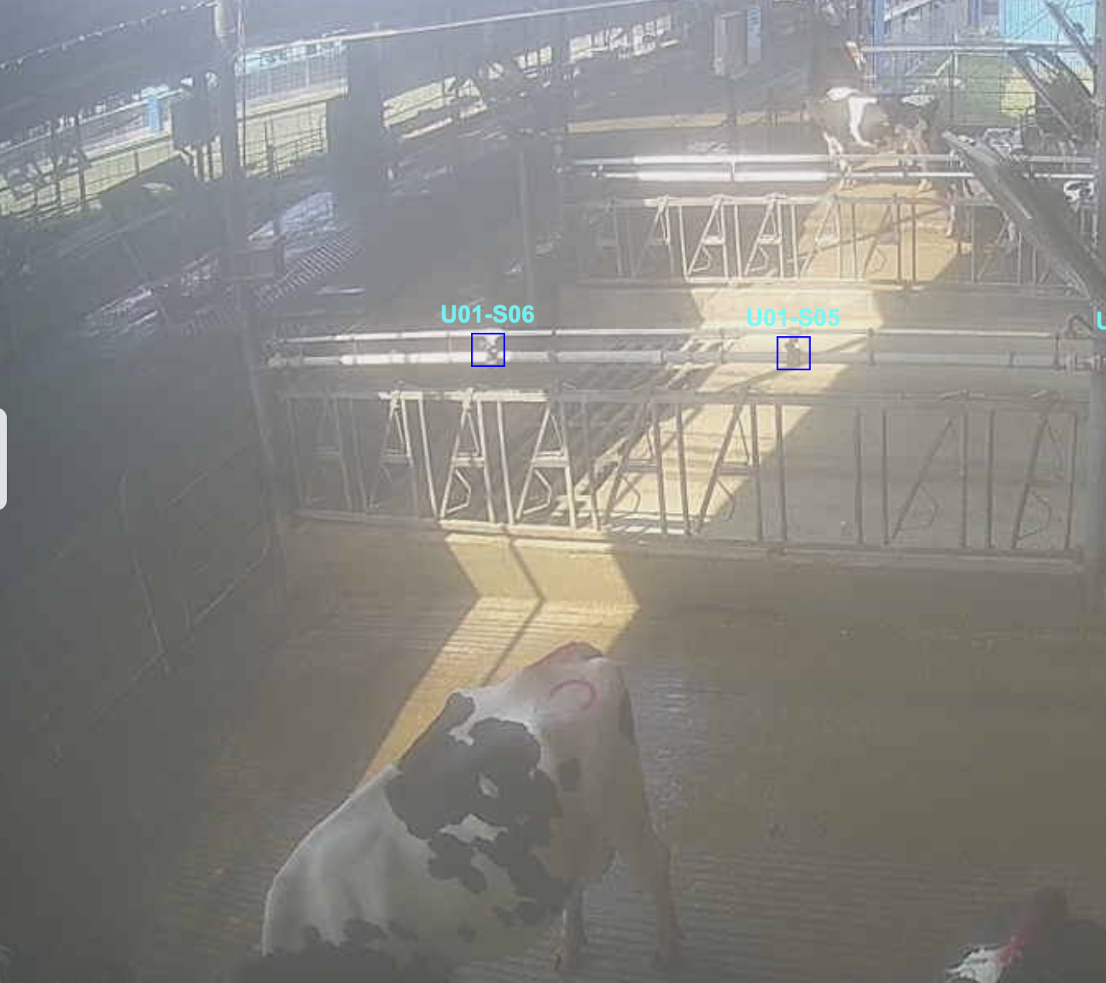
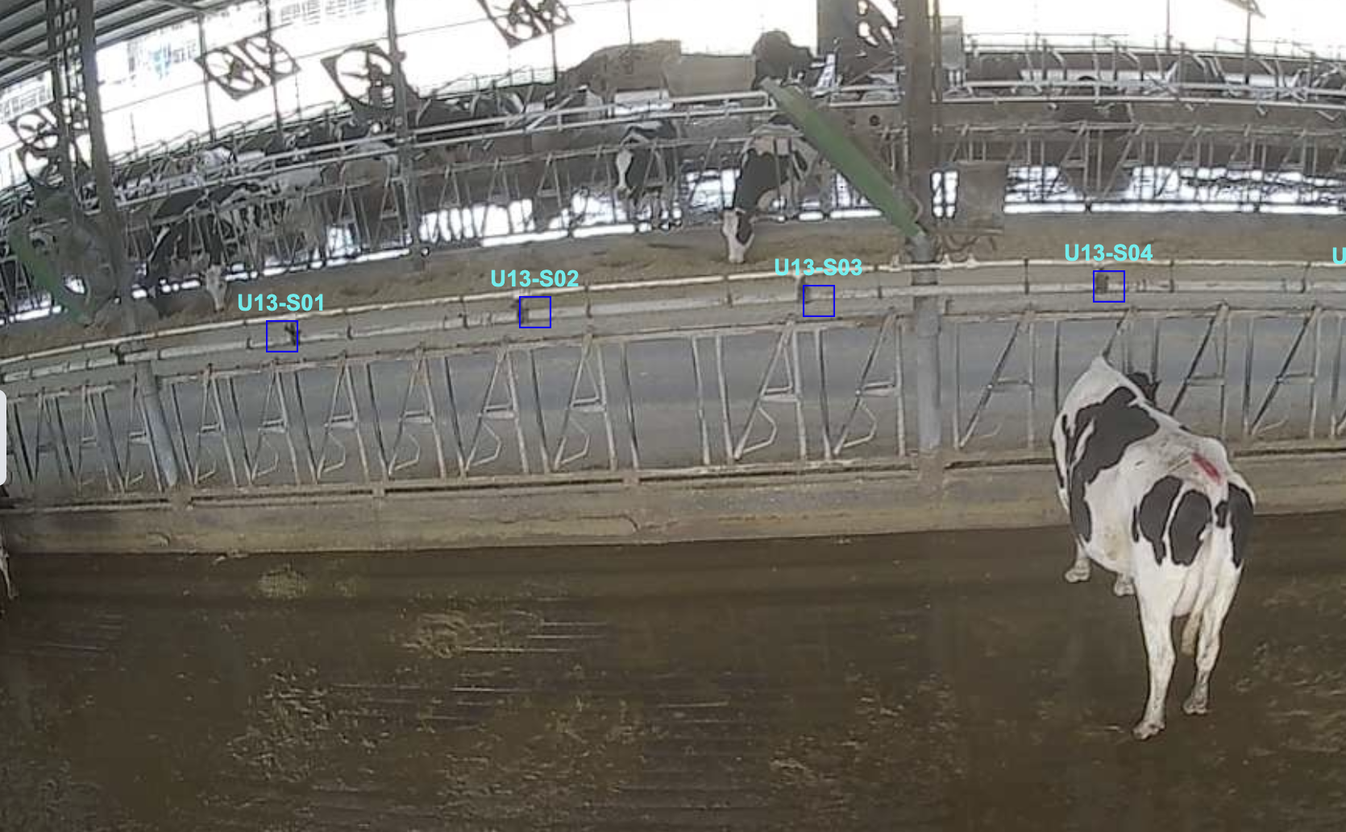
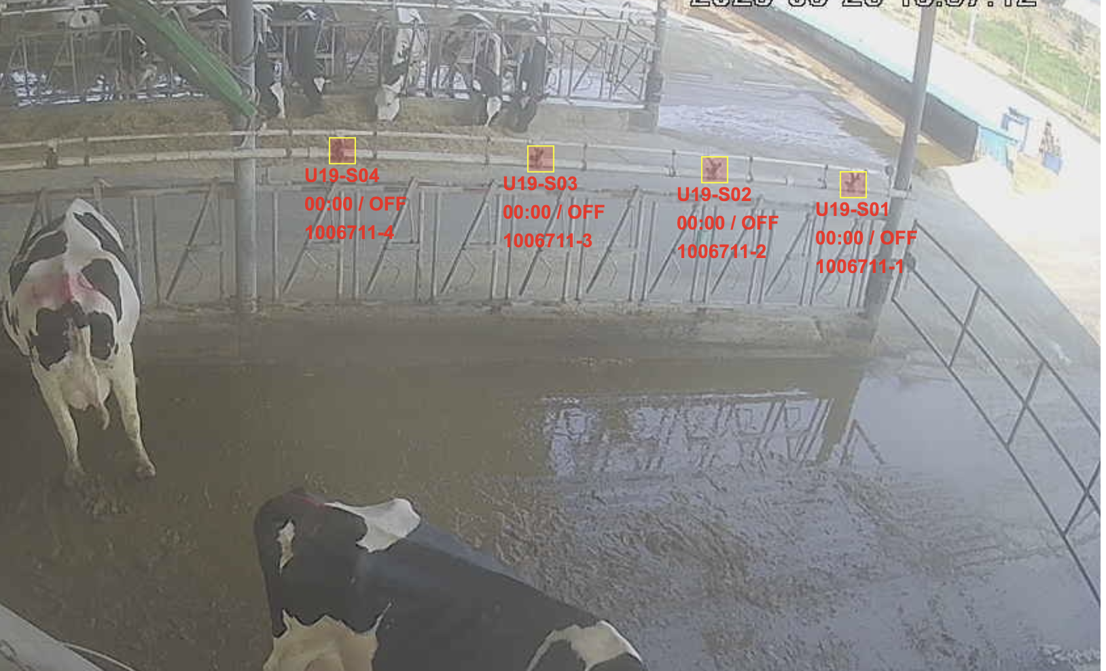
From TAAA Farm 2025.5.15-2025.5.23 date
牛舍采食均匀度分析
Barn feed intake uniformity analysis
关于均匀度一致性的分析 Analysis of uniformity consistency:：
1. 牛舍整体采食分布较为均匀，使用时长低于平均值30%以上的区域占比9%左右。
The overall feed intake distribution in the barn is relatively uniform, using duration lower than average 30% area account for around 9%.
2. 牛舍采食分布呈现外侧高，内侧低的趋势，但差异并不明显。
The feed intake distribution in the barn shows a trend of higher intake on the outer side and lower intake on the inner side, but the difference is not significant.
3. 牛舍中有些特殊区域，出现了过高或者过低的问题，具体原因分析如下。
There are some specific areas in the barn that have shown unusually high or low intake. The detailed analysis of the reasons is as follows.
Feed intake duration
120% Ave
Ave
80% Ave
阳光直晒对采食的影响
Direct sunlight impact feed intake
去掉摆臂的孔位明显更受到奶牛的欢迎
The design without the armrest holes is
significantly more popular among cows
最靠边的位置使用很少，原因有待研究
The most marginal position is rarely used
and the reasons for this still need to be studied
Notes:
这次准备的资料一共是5张，主要集中在5个方面：
奶牛采食均匀度
奶牛躺卧均匀度
挤奶班次流畅度
推料作业分析
奶牛饮水均匀度
这些都是基于11舍的数据导出的，其他牛舍或者未来的其他数据都是一个道理
第一张片子，针对采食均匀度的导出和分析
图表的横坐标是采食区域或者喷淋区域的编号（比如 U01S01）,通过抓取奶牛在这些区域的时间，推测出采食时长。整个区域差不多300多个颈夹，我们把它分成100多个区域。通过对每个区域的统计，就能看出它的分布是否均匀。总体来说是比较均匀的。
表格中红线是它的平均值，灰色区域是高于平均值20%或者低于平均值20%的范围。（20%太苛刻了，所以做统计时是按照30%统计的）
1. 高于30%的不必特别着重关注，使用时长低于平均值30%的区域占比9%左右，整体来说，采食均匀度不错。
2. 奶牛采食分布呈现外侧高，内侧低的趋势。进一步分析发现，外侧是靠近室外，内侧是靠近转群通道。当然具体的原因没法再做进一步分析了。整体呈现靠近牛舍外侧使用时间长，靠近内侧使用时间少的一种特征。
3. 牛舍中有些特殊区域，出现了过高或者过低的问题。
比如说U01S05/U01S06/U19S01尤其低，分析原因：U01S05/U01S06位置有阳光带，可能奶牛觉得热或者其他原因，奶牛不爱待。U19S01是最靠近牛舍外侧的位置，奶牛也不愿意待。
中间有一段非常有规律，出现一个奶牛特别喜欢光顾的区域，查了下，这种区域有一个共同的特征，就是颈夹的摆臂给摘了，现场应该是过人通道。说明奶牛还是更趋于使用这种压力比较小的采食位置。

Slide 36

From TAAA Farm 2025.5.15-2025.5.23 date
关于躺卧均匀度一致性的分析 Analysis of lying uniformity consistency:
每头牛平均每天躺卧时长12个小时（274头存栏计算）Average lying time per cow is 12 hours per day (using 274 hds for calculating)
卧床使用分布呈现颈夹侧卧床明显高于外侧卧床的情况。The distribution of bed usage shows that the headlock side beds are significantly higher than the outer side beds.
卧床躺卧时长超过平均值30%的占比25.4%（77个）25.4% (77 EA) of the beds have lying times exceeding the average 30%
卧床躺卧时长低于平均值30%的占比21.8%（66个）21.8% (66 EA) of the beds have lying times below the average 30%
红色部分为使用频率较低的卧床，需要重点关注The red section indicates beds with lower usage frequency, requiring special attention.
牛舍躺卧均匀度分析
Barn lying uniformity analysis
Headlock Side
Milking Passage
Exit Side
Passage Side
Notes:
通过安装的摄像头实时追踪每一个卧床的时间，来分析牛群的躺卧均匀度。我们得出5个结论：
每头牛平均每天躺卧时长12小时。按照274头存栏计算，5.16-5.23这一周的统计区间，可以达到12小时。
卧床使用呈现靠近颈夹侧明显高于靠近外侧的情况。符合咱们实际的认知。
卧床躺卧时长超过平均值30%的占比25.4%（77个）。 柱形图比较长的是奶牛特别喜欢去躺卧的
卧床躺卧时长低于平均值30%的占比21.8%（66个）。
红色部分为使用频率较低的卧床。 我们标注了奶牛不喜欢的卧床的位置，感兴趣的话可以让一线同事去关注下奶牛不愿意去的原因可能有哪些，也许能帮咱们把奶牛的舒适度再提升一下。
整体来说，总体的躺卧时间是够的，但是从内外来看，它的分布还是有一点点不均匀的情况。

Slide 37
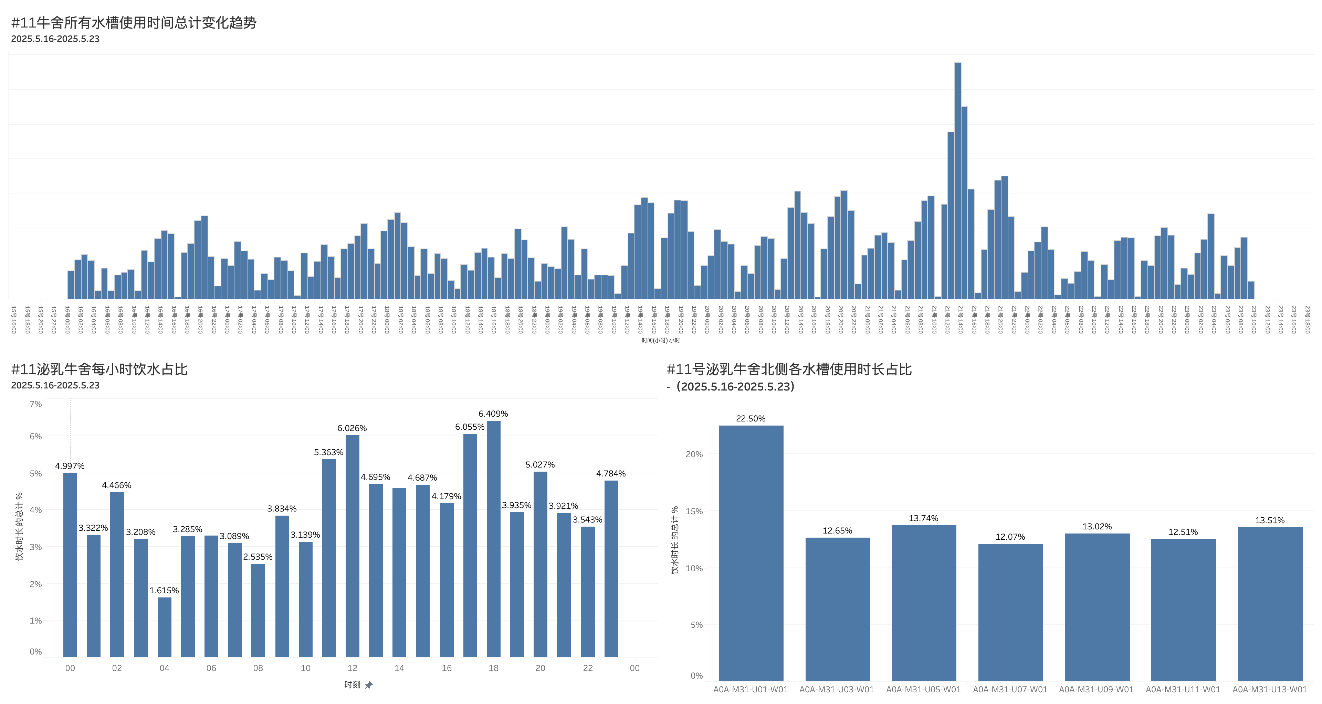
From TAAA Farm 2025.5.15-2025.5.23 date
牛舍饮水均匀度分析
Barn water intake uniformity analysis
#11 barn all water troughs using time change trend
5月21日下午13:00-14:00， THI达到88.1，处于近一周以来的最高值，与之对应的，5月21日下午13:00-14:00的饮水时长也出现了显著增长。
From 13:00 to 14:00 on May 21, the THI reached 88.1, the highest value in nearly a week, and correspondingly, the drinking time from 13:00 to 14:00 on May 21 also increased significantly.
凌晨4:00-5:00间，奶牛饮水最少
中午12:00-13:00间，下午17:00-19:00间，奶牛饮水最多
Between 4:00 a.m. and 5:00 a.m., cows drink the least amount of water
Between 12:00-13:00 and 17:00-19:00., cows drink the most water
最靠近挤奶通道的水槽，使用时间越长
Water troughs that near the milking passage most, the longer being used.
#11 milking barn per hour water intake%
#11 milking barn north side water troughs using time%
Notes:
还有一个均匀度是跟饮水相关。这里边有三张图表。
1. 最上方的图表（#11牛舍所有水槽时间时间总计变化趋势）是以时间为轴线，把所有水槽的使用时长加总以后，得出奶牛每一个小时的饮水时长变化，也就是饮水量的变化。
这个表格比较有意思的一点：5月21日下午13：00-14:00的饮水时长出现了显著增长，查了下天气，5月21日下午13:00-14:00， THI达到88.1，处于近一周以来的最高值。估计是天气热的原因，奶牛比较渴。温度变高，相应地出现了饮水行为的变化。
2. 左下图表（#11泌乳牛舍每小时饮水占比）是把所有水槽的使用时长以24小时统计，这7天到底哪个一个小时奶牛喝水比较多，哪时段喝水比较少。得出一个结论：凌晨4:00-5:00间，因为睡觉或者别的原因，奶牛饮水最少；中午12:00-13:00间，下午17:00-19:00间，奶牛饮水最多。
3. 右下图表（#11泌乳牛舍每个水槽使用时长占比），统计牛群内7个水槽的使用时长占比。发现第一个水槽最靠近挤奶通道，使用时长最长，占了22.5%，其他水槽基本上分配比较均匀。

Slide 38
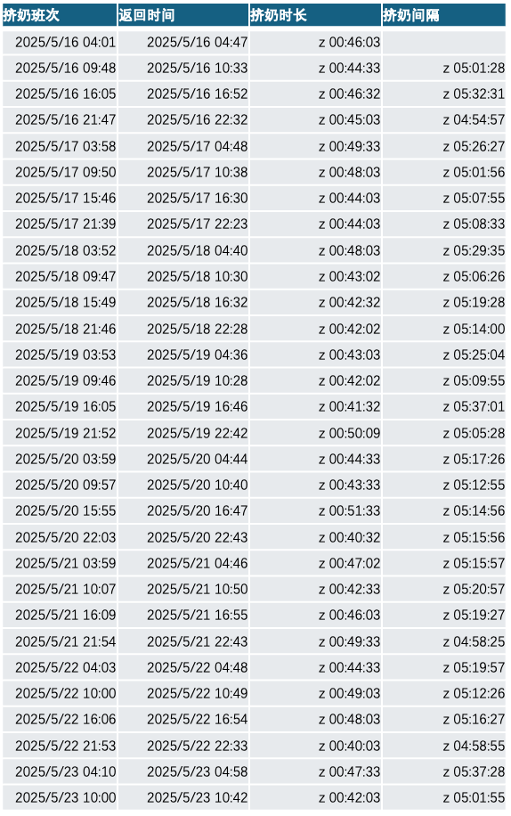
From TAAA Farm 2025.5.15-2025.5.23 date
牛舍挤奶流畅度分析
Barn milking smoothness analysis
#11 milking barn north side barn empty duration when milking and milking interval
Shifts
Return
Duration
Interval
Barn empty duration when milking(min)
1. 从奶牛离舍返舍角度考量，每次挤奶时长较为平均，最低的一次40分钟，最高的一次52分钟。
Considering the time taken for cows to leave and return to the barn, the duration of each milking session is relatively consistent, with the shortest was 40 minutes and the longest was 52 minutes.
2. 从两个挤奶班次的间隔角度考量，挤奶间隔稍有波动。最长的一次两次挤奶间间隔337分钟，最短的一次间隔295分钟。
From the perspective of the intervals between two milking shifts, there is a slight fluctuation. The longest interval between two milking sessions was 337 minutes, while the shortest was 295 minutes.
Milking interval (min)
Milking Shifts (May 2025)
Notes:
把11号牛舍离舍和返舍时间拿回来做分析
右图表格：统计每天的挤奶班次、返回时间的具体时间，以及计算出来的挤奶时长、挤奶间隔。
左图是这个表格图形化的呈现。下面橘色部分是：每次挤奶班次的用时。
从奶牛离舍返舍角度考量，每次挤奶时长较为平均，最低的一次40分钟，最高的一次52分钟。具体需要回到21号那天去分析。
总体来说还是比较均匀的。
上面折线图是：两个挤奶班次的时间间隔。也就是奶牛在牛舍里呆的时间。也是比较均匀的，最长的一次两次挤奶间间隔337分钟，最短的一次间隔295分钟。中间有些波动，多数情况下是正常的。一天四次挤奶，整体班次的流动情况，至少这周看是比较平顺的。

Slide 39
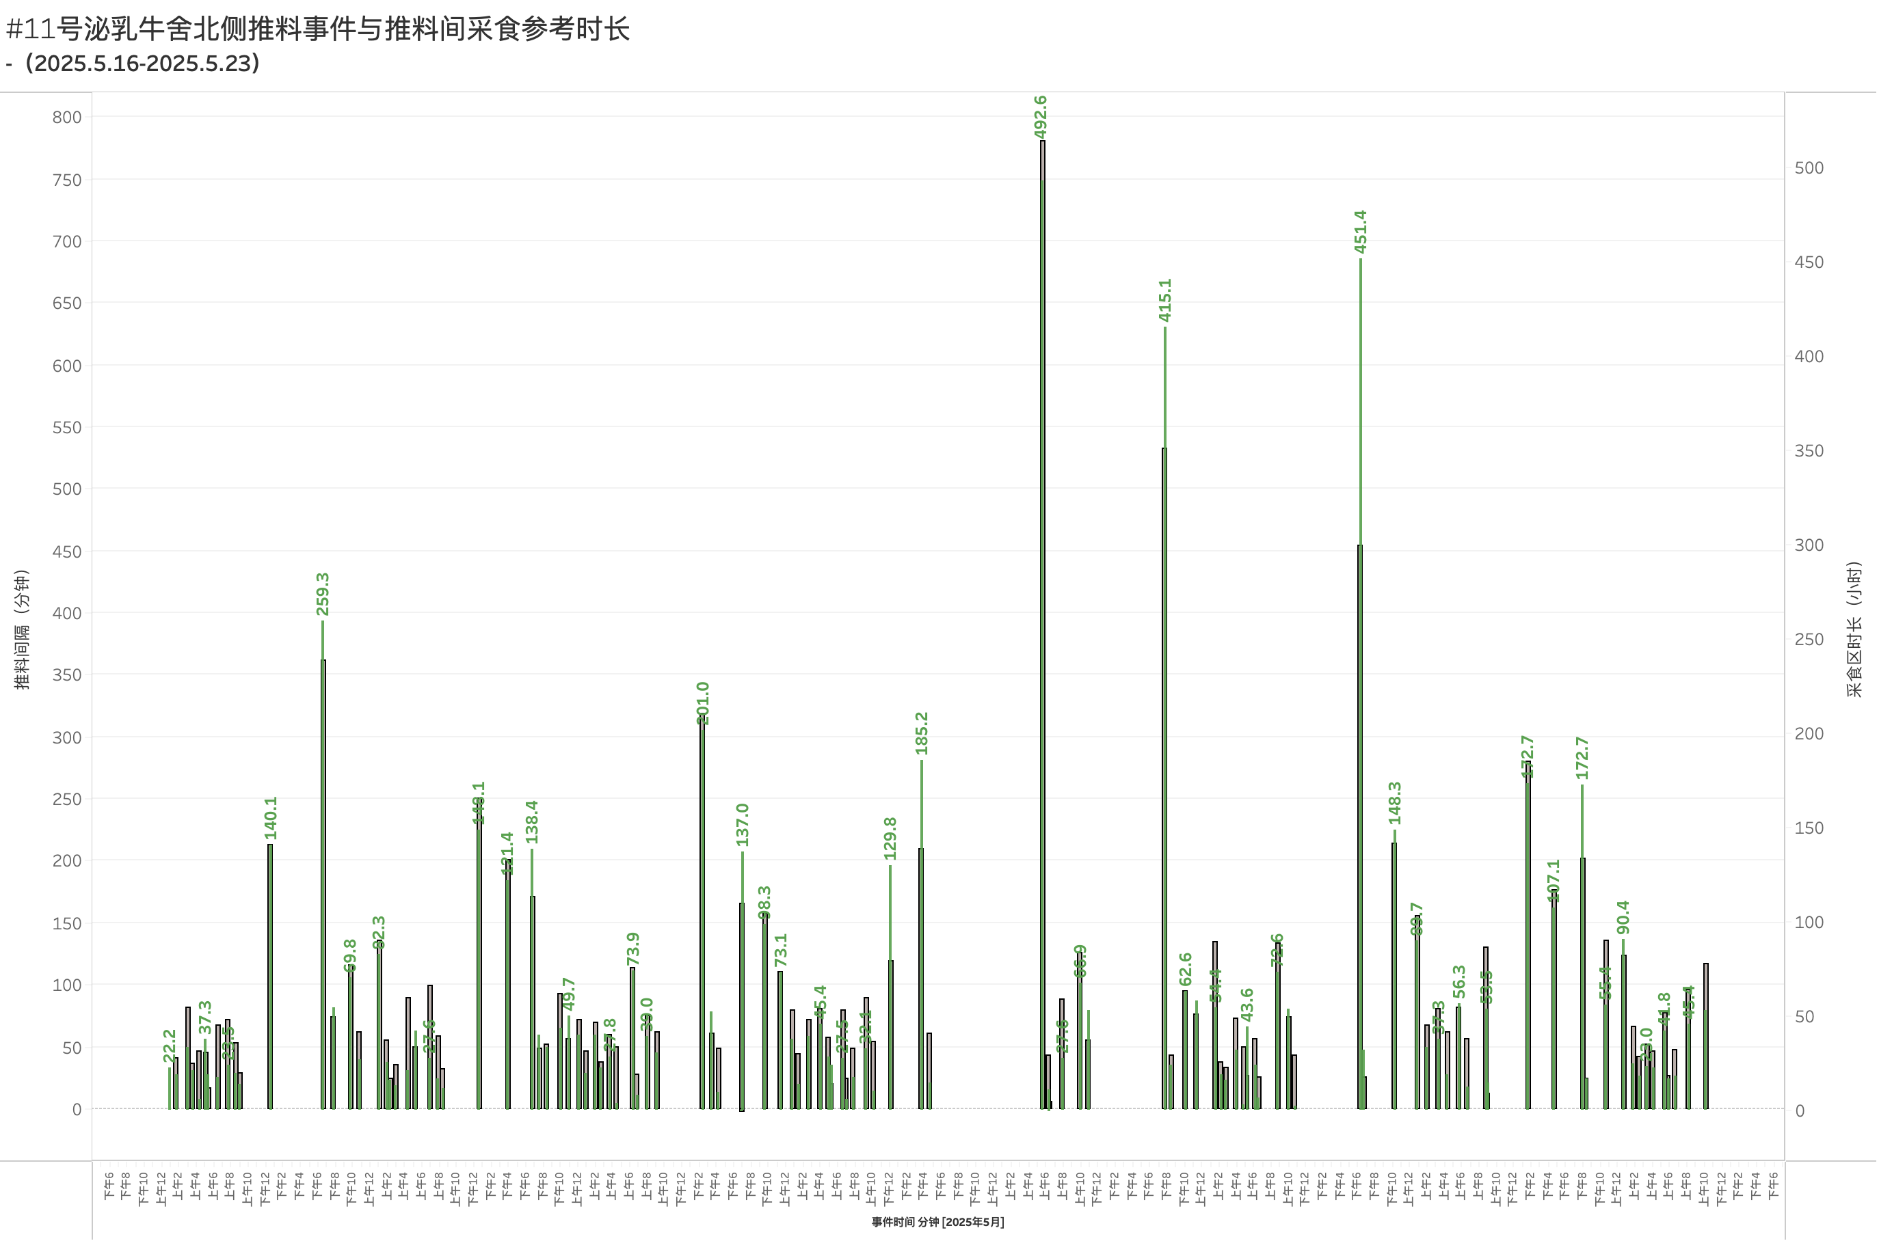
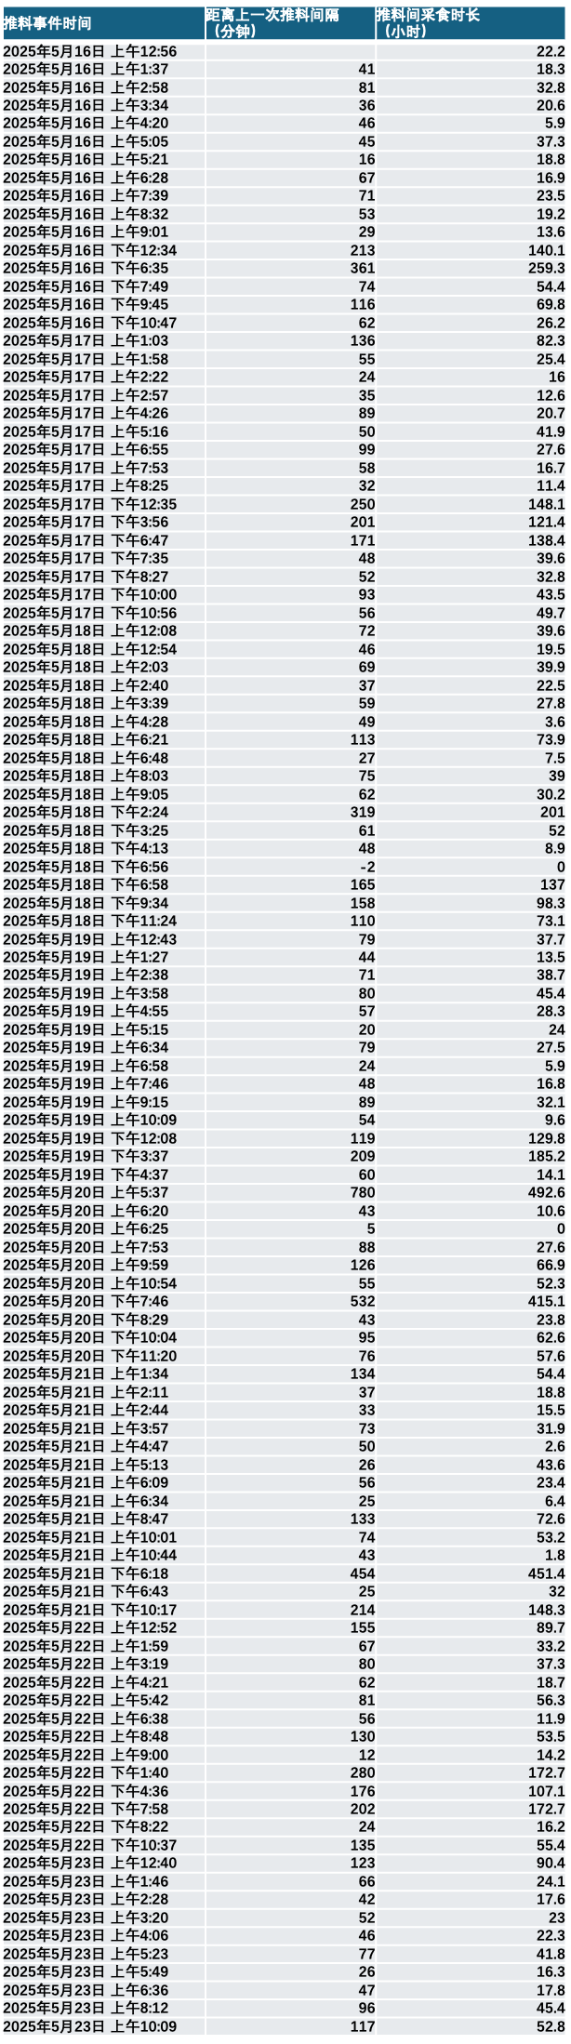
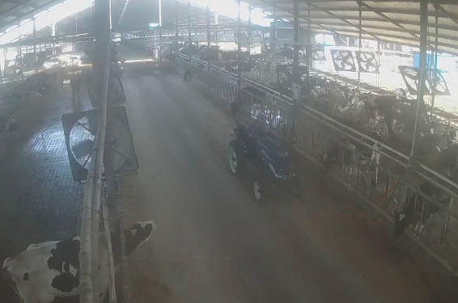
﻿推料事件时间 | 距离上一次推料间隔 （分钟） | 推料间采食时长 （小时）
2025年5月16日 上午12:56 |  | 22.2
2025年5月16日 上午1:37 | 41 | 18.3
2025年5月16日 上午2:58 | 81 | 32.8
2025年5月16日 上午3:34 | 36 | 20.6
2025年5月16日 上午4:20 | 46 | 5.9
2025年5月16日 上午5:05 | 45 | 37.3
2025年5月16日 上午5:21 | 16 | 18.8
2025年5月16日 上午6:28 | 67 | 16.9
2025年5月16日 上午7:39 | 71 | 23.5
2025年5月16日 上午8:32 | 53 | 19.2
2025年5月16日 上午9:01 | 29 | 13.6
2025年5月16日 下午12:34 | 213 | 140.1
2025年5月16日 下午6:35 | 361 | 259.3
2025年5月16日 下午7:49 | 74 | 54.4
2025年5月16日 下午9:45 | 116 | 69.8
2025年5月16日 下午10:47 | 62 | 26.2
2025年5月17日 上午1:03 | 136 | 82.3
2025年5月17日 上午1:58 | 55 | 25.4
2025年5月17日 上午2:22 | 24 | 16
2025年5月17日 上午2:57 | 35 | 12.6
2025年5月17日 上午4:26 | 89 | 20.7
2025年5月17日 上午5:16 | 50 | 41.9
2025年5月17日 上午6:55 | 99 | 27.6
2025年5月17日 上午7:53 | 58 | 16.7
2025年5月17日 上午8:25 | 32 | 11.4
2025年5月17日 下午12:35 | 250 | 148.1
2025年5月17日 下午3:56 | 201 | 121.4
2025年5月17日 下午6:47 | 171 | 138.4
2025年5月17日 下午7:35 | 48 | 39.6
2025年5月17日 下午8:27 | 52 | 32.8
2025年5月17日 下午10:00 | 93 | 43.5
2025年5月17日 下午10:56 | 56 | 49.7
2025年5月18日 上午12:08 | 72 | 39.6
2025年5月18日 上午12:54 | 46 | 19.5
2025年5月18日 上午2:03 | 69 | 39.9
2025年5月18日 上午2:40 | 37 | 22.5
2025年5月18日 上午3:39 | 59 | 27.8
2025年5月18日 上午4:28 | 49 | 3.6
2025年5月18日 上午6:21 | 113 | 73.9
2025年5月18日 上午6:48 | 27 | 7.5
2025年5月18日 上午8:03 | 75 | 39
2025年5月18日 上午9:05 | 62 | 30.2
2025年5月18日 下午2:24 | 319 | 201
2025年5月18日 下午3:25 | 61 | 52
2025年5月18日 下午4:13 | 48 | 8.9
2025年5月18日 下午6:56 | -2 | 0
2025年5月18日 下午6:58 | 165 | 137
2025年5月18日 下午9:34 | 158 | 98.3
2025年5月18日 下午11:24 | 110 | 73.1
2025年5月19日 上午12:43 | 79 | 37.7
2025年5月19日 上午1:27 | 44 | 13.5
2025年5月19日 上午2:38 | 71 | 38.7
2025年5月19日 上午3:58 | 80 | 45.4
2025年5月19日 上午4:55 | 57 | 28.3
2025年5月19日 上午5:15 | 20 | 24
2025年5月19日 上午6:34 | 79 | 27.5
2025年5月19日 上午6:58 | 24 | 5.9
2025年5月19日 上午7:46 | 48 | 16.8
2025年5月19日 上午9:15 | 89 | 32.1
2025年5月19日 上午10:09 | 54 | 9.6
2025年5月19日 下午12:08 | 119 | 129.8
2025年5月19日 下午3:37 | 209 | 185.2
2025年5月19日 下午4:37 | 60 | 14.1
2025年5月20日 上午5:37 | 780 | 492.6
2025年5月20日 上午6:20 | 43 | 10.6
2025年5月20日 上午6:25 | 5 | 0
2025年5月20日 上午7:53 | 88 | 27.6
2025年5月20日 上午9:59 | 126 | 66.9
2025年5月20日 上午10:54 | 55 | 52.3
2025年5月20日 下午7:46 | 532 | 415.1
2025年5月20日 下午8:29 | 43 | 23.8
2025年5月20日 下午10:04 | 95 | 62.6
2025年5月20日 下午11:20 | 76 | 57.6
2025年5月21日 上午1:34 | 134 | 54.4
2025年5月21日 上午2:11 | 37 | 18.8
2025年5月21日 上午2:44 | 33 | 15.5
2025年5月21日 上午3:57 | 73 | 31.9
2025年5月21日 上午4:47 | 50 | 2.6
2025年5月21日 上午5:13 | 26 | 43.6
2025年5月21日 上午6:09 | 56 | 23.4
2025年5月21日 上午6:34 | 25 | 6.4
2025年5月21日 上午8:47 | 133 | 72.6
2025年5月21日 上午10:01 | 74 | 53.2
2025年5月21日 上午10:44 | 43 | 1.8
2025年5月21日 下午6:18 | 454 | 451.4
2025年5月21日 下午6:43 | 25 | 32
2025年5月21日 下午10:17 | 214 | 148.3
2025年5月22日 上午12:52 | 155 | 89.7
2025年5月22日 上午1:59 | 67 | 33.2
2025年5月22日 上午3:19 | 80 | 37.3
2025年5月22日 上午4:21 | 62 | 18.7
2025年5月22日 上午5:42 | 81 | 56.3
2025年5月22日 上午6:38 | 56 | 11.9
2025年5月22日 上午8:48 | 130 | 53.5
2025年5月22日 上午9:00 | 12 | 14.2
2025年5月22日 下午1:40 | 280 | 172.7
2025年5月22日 下午4:36 | 176 | 107.1
2025年5月22日 下午7:58 | 202 | 172.7
2025年5月22日 下午8:22 | 24 | 16.2
2025年5月22日 下午10:37 | 135 | 55.4
2025年5月23日 上午12:40 | 123 | 90.4
2025年5月23日 上午1:46 | 66 | 24.1
2025年5月23日 上午2:28 | 42 | 17.6
2025年5月23日 上午3:20 | 52 | 23
2025年5月23日 上午4:06 | 46 | 22.3
2025年5月23日 上午5:23 | 77 | 41.8
2025年5月23日 上午5:49 | 26 | 16.3
2025年5月23日 上午6:36 | 47 | 17.8
2025年5月23日 上午8:12 | 96 | 45.4
2025年5月23日 上午10:09 | 117 | 52.8
1. 推料作业间隔不一致的情况较多 Inconsistency of feed push interval happens high
（*推料车辆仅识别图中车辆，其他车辆用作推料的情况未予统计）(*Pushing vehicles only recognize vehicles in the image, and other vehicles used for pushing feed are not counted.)
2. 存在较长时间不推料的情况 Had situations where feeds were not pushed for a long time.
3. 存在较短时间反复推料的情况 Had situations where feeds were repeatedly pushed in a short time.
牛舍推料执行分析
Barn feed push implementation analysis
Feed event
Feed intake duration between feed pushing
Feeding interval
#11 milking barn north side feed pushing events and feed intake duration between feed pushing
灰色柱形指距离上次推料的间隔时长
Gray bars indicate the duration since the last feed pushing
绿色柱形指两次推料间采食区被奶牛占用的时间总计
Green bars indicate the total time the feeding area being occupied by cows between two feed pushing
Feed pushing interval (min)
Feed intake area duration (hr)
Feed pushing event/Min (May 2025)
Notes:
我们把推料车工作做了一个记录。系统认为蓝色的这个拖拉机是推料车（*推料车辆仅识别图中车辆，其他车辆用作推料的情况未予统计）。
整体结果出来以后，直白的说，不太好。
灰色柱形代表这次推料和上次推料的时间间隔长度，以分钟来计算的。
绿色柱形代表这两次推料之间，所有牛的总计采食时长。
这两个数据来看，整体是分布不均匀。
说明两种情况：1. 很长时间不推料。图中红色区域是很长时间推料车没来。
2. 短时间内推料车反复推。不到半小时就推一次料。
这两种情况在11群都出现过。
单纯从现在数据角度来看，咱们推料可能还有一定的优化和提升的空间。
右图是系统抓取到的推料事件，推料发生时间/距离上次推料的间隔时长/这两次推料之间的奶牛采食时长。
右边是详细数据的表格，左边是这张表格的数据化呈现。
其实推料这块，每一个牧场都有每个牧场的做法，那么可能这次提供的资料和咱们实际的现实有一定的偏差。这块咱们后期想做的更精准一点，那么您可以随时召唤我们。我们去现场跟咱们场长好好的去沟通一下，看看这个地方怎么样能够帮助咱们一线去更好的管理推料这件事情。
其实这5张片子并没有涵盖这套系统能够给您提供的所有的功能。只是把我们认为比较重点的，还有就是咱们现场安装的设备具备的能够达到的一些功能，这次给您做了五张这样的片子来做介绍。

Slide 40
1、8月份夏季最低产量43.7公斤与5月份最高产量47.4公斤比，降幅8% ADM 43.7KG in Aug VS ADM 47.4 in May decrease by 8%
2、8月份夏季最低产量43.7公斤与全年平均产量45.4公斤比，降幅4% ADM 43.7KG in AugVS Annual average ADM decrease by 4%

Slide 41

        Thank you for your attention!

